Slide 1


Building Partnerships Founded on Principles of National Core Arts Standards
Marcia McCaffrey, President, SEADAE
Cory Wilkerson, Project Manager, SEADAE
Joyce Huser, SEADAE-Executive Committee, Kansas State Dept. of Education & Member of the Visual Arts Writing Team for National Art Education Assoc.

Slide 2
Today’s Session
Investigate key components of the National Core Arts Standards
Tour the website—your “go to” site
Construct personal meaning with the new standards
Reflect on the relationship between your work and the standards
Imagine other possibilities for your work in relation to the standards

Slide 3
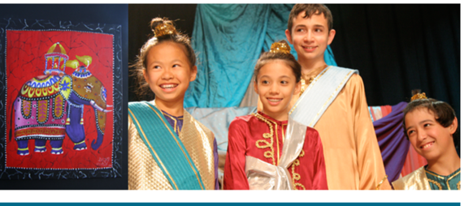
Data baseline.....getting to know you

Slide 4

Raise your hand if you ..
Are a teaching artist
Are a classroom teacher
Are an administrator
Are a researcher
Are in higher ed
Are a museum educator

Slide 5
Raise your hand if you ..
Love the new standards- visited the website and
started using them in your work.

Slide 6
Raise your hand if you...
A somewhat familiar with the new arts standards
but haven’t really used them yet.

Slide 7
Raise your hand if you...
Know very little about the new standards and
am here to see what they are all about.

Slide 8

Ten national organizations spent 3 years designing and writing new national voluntary standards for the arts.

Slide 9
NCCAS Leadership Organizations
American Alliance for Theatre and Education
Americans for the Arts
The College Board
Educational Theatre Association
National Art Education Association
National Association for Music Education
National Dance Education Organization
NCCAS Media Arts Committee
State Education Agency Directors of Arts Education
Young Audiences Arts for Learning
Notes:
Over the course of three years, the writing teams and NCCAS leadership, across five disciplines of dance, media arts, music, theatre and visual arts came together in person and virtually to create new arts standards.

Slide 10
By the Numbers
2013 Views of Standards (PK-8)
Dance 4587
Media Arts 2742
Music 24,118
Theatre 6738
Visual Arts 23,852
2014 Views of Standards (+HS and MCA grade 8)
Dance 2949
Media Arts 2824
Music 23,380
Theatre 2896
Visual Arts 17,338
6,000 completed surveys
Notes:
Leadership took the comments and survey results very seriously, using them to guide changes to the work along the way. SEADAE members also created state teams and provided feedback to Leadership through state reports, another valuable source for guiding the work.

Slide 11
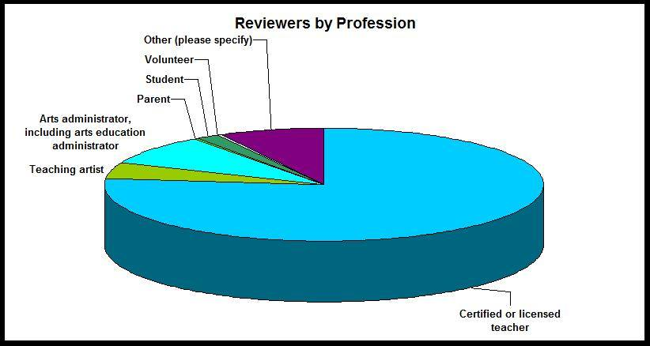
Reviewers

Slide 12
National Federal Government
Notes:
National service organizations provided the backing for the work, not the Federal Government, not federal funding nor legislative mandate. The National Endowment for the Arts provided funds to bring in master artists, one for each arts discipline in the standards project, to provide feedback to teams. Other than that, no federal dollars were used in the writing of these new standards.

Slide 13
Core Arts CCSS
Arts defined as a core academic subject:
Elementary and Secondary Education Act
1994 Goals 2000
2001 No Child Left Behind
NCLB Title IX- General Provisions
(11) CORE ACADEMIC SUBJECTS- The term core academic subjects' means English, reading or language arts, mathematics, science, foreign languages, civics and government, economics, arts, history, and geography.
Notes:
Core is maintained in the title to remind people that the arts are “core” in Federal legislation—Now we are talking about the feds, ESEA, currently known as No Child Left Behind. Many people do not realize that the arts are identified as a core subject under NCLB. Therefore, the term “core” in the National Core Arts Standards is a reference to arts as a core subject, not as a tie-in with the Common Core State Standards.

Slide 14
Small Group Conversation
What’s a standard?
What’s the purpose of standards?
  A measurable statement describing what students should know and be able to do.
  Collectively, standards demonstrate the breadth and depth of the learning expectations for a discipline.

Slide 15
Important to Remember…!
National
State
Local
Model standards are created at the NATIONAL level….
Standards are reviewed, vetted, and/or (re)written and then adopted at the STATE level…
Standards are enacted at the LOCAL level…
Notes:
This slide was included to set the context for state adoption or adaptation. This underscores that national organizations such as Achieve or the National Governor’s Association initiate the development of standards. Because of our passion for a federalism states are left to make decisions about education. State boards of education or legislatures therefore determine if a state will adopt standards. Ultimately standards are put into practice in local school district or charter school classrooms.

Slide 16

Why study the arts? What is it about the arts that makes the experience valuable to students, to education, to a community, to a nation?
What “arts learnings” do we want students to take with them through their life?
Notes:
The writing chairs began with the end in mind by address these questions. How might you answer these questions? Take time to go around the room or work in small groups to come up with contributions the arts make to a student’s education.

Slide 17
Artistic Literacy =
Philosophical Foundations + Life Long Goals
Notes:
The new Core Arts Standards define artistic literacy for all students. A conceptual framework document begins with a set of Philosophical Foundations and goals for life-long learning.
17

Slide 18
Philosophical Foundations | Lifelong Goals (Defining Artistic Literacy)
Communication | Artistically literate citizens use a variety of artistic media, symbols, and metaphors to independently create and perform work that communicates their own ideas, and are able to respond by analyzing and interpreting the artistic communications of others.
Creative Personal Realization | Artistically literate citizens find at least one art form in which they develop sufficient competence to continue active involvement in that art form as an adult.
Culture, History, and Other Connections | Artistically literate citizens know and understand artwork from varied historical periods and cultures, and actively seek and appreciate diverse forms and genres of artwork of enduring quality/significance. They also understand relationships among the arts, and cultivate habits of searching for and identifying patterns and relationships between the arts and other knowledge.
Wellbeing | Artistically literate citizens find joy, inspiration, peace, intellectual stimulation, meaning, and other life-enhancing qualities through participation in all of the arts.
Community Engagement | Artistically literate citizens seek artistic experience and support the arts in their local, state, national, and global communities.
Notes:
These underpin the structure of the standards and weave throughout each component – overarching anchor standards, discipline specific performance standards and instructional support materials.

Slide 19
Artistically literate students
Use a variety of artistic media, symbols, and metaphors to communicate their own ideas and to respond to the artistic communications of others.
Develop creative personal realization in at least one art form in which they continue active involvement as an adult.
Cultivate culture, history, and other connections through diverse forms and genres of artwork.
Find joy, inspiration, peace, intellectual stimulation, and meaning when they participate in the arts.
Seek artistic experiences and support the arts in their communities.
Notes:
The lifelong goals make clear the end game : to be artistically literate means to utilize media, symbols and metaphor to play with and communicate ideas, it means to turn to the arts for creative personal realization, to know and understand the arts as a deep connection to our cultures and our history, to find joy and well being in the arts and seek out arts experiences in their community.

Slide 20
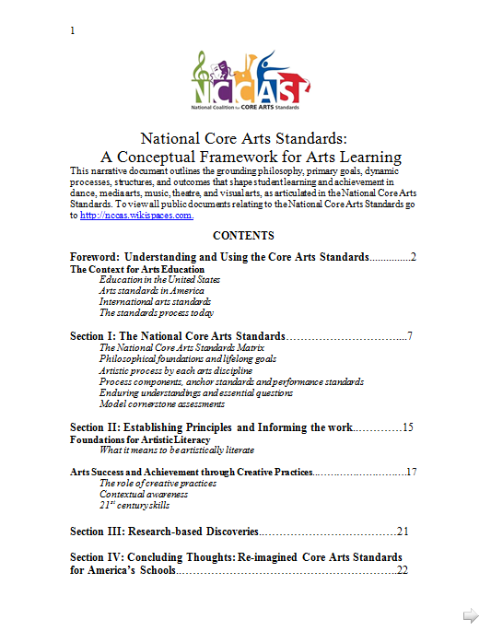
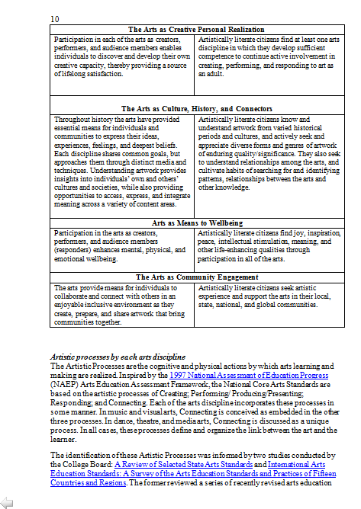

Slide 21
Design Feature
Artistic Processes
Notes:
The Artistic Process are the largest common denominator in the design of the core arts standards. These 4 processes are shared among the arts disciplines and form the overarching big ideas for all the standards.

Slide 22
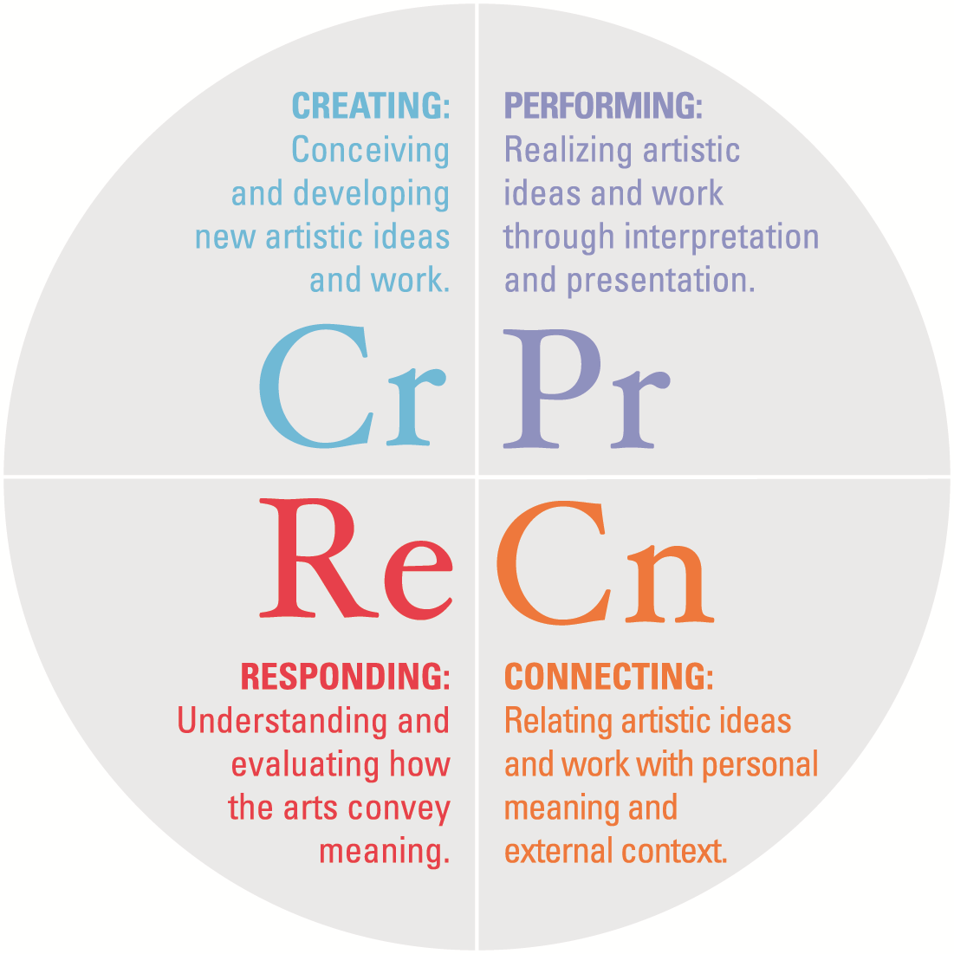


Artistic Processes
are the way the brain and body make art and define the link between art making and the learner
Notes:
Unlike the old 1994 standards - held together only by the book - The standards are based on a process model- organized through four common Artistic Processes:
Creating:
Performing:
Responding:
Connecting:
All five disciplines organize their grade by grade standards through the four artistic processes, with connecting as embedded within the Music standards.

Slide 23
CREATING AND THE 3 P’S
Creating is specifically about conceiving and developing works of arts. In other words, the “making” of the art – as director, choreographer, designer, producer, conductor, composer, painter.
Performing/Presenting/Producing is about the realizing, sharing or presenting the art or the “doing” of the art – as the actor, dancer, curator, musician, technician.

Slide 24
CONNECTING
Connecting is relating artistic ideas and work with personal meaning and external context.
It is generally considered a distinct process among most art forms, although music views this process as embedded within the other processes.
It is significantly beyond Arts Integration or defining other subject matter through arts understandings.

Slide 25
RESPONDING VS. CONNECTING DIFFERENCE?
Responding is a reflection on an external set of information. It is generally focused through comparison and critical analysis.
Connecting is an internal process mechanism that synthesize various bodies of knowledge for use in developing multiple entry points for personal expression.

Slide 26


Slide 27
Artistic Processes
Shared among the 5 arts disciplines
Overarching-big buckets
Anchor Standards
Shared among the 5 arts disciplines
Begin to breakdown the artistic processes
Performance Standards
Unique to each of the 5 arts disciplines
Incremental, observable, measurable
The “standards”
Notes:
The design of the standards from the Artistic Processes to the Anchor Standards, performance standards and the various instructional resources fit together like nested dolls—

Slide 28
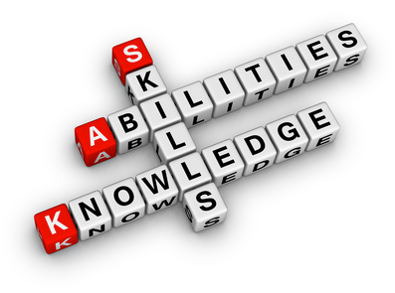
Performance Standards
Translate the anchor standards into measureable goals that articulate student achievement.
Are written PreK-8 at grade level and at three levels of proficiency for high school: proficient, accomplished, and advanced.
Notes:
Unlike the 1994 standards which were written in grade bands. The 2014 standards provide grade-by-grade performance standards from PreK– 8th Grade, and three levels for High School- proficient, accomplished and advanced.
Providing grade-by-grade standards addresses requests from several state education agencies while also mirroring best practice in other academic areas. New arts standards outline an age-appropriate developmental progression of artistic study that provides a state-of-the-art foundation for curriculum, instruction and assessment. The three levels of high school standards – proficient, accomplished, and advanced – acknowledge the range of skills and knowledge that students possess as they begin their secondary school years. The new arts standards call for all students to achieve at least the proficient level, and preferably the accomplished level, in at least one arts discipline by the end of their PreK-12 schooling.
(slide provided by Jim Palmarini of EdTA)

Slide 29
4 Artistic Processes
11 Core Arts Anchor Standards
Discipline Specific Performance Standards
Discipline-based instructional resources
EU’s & EQ’s
Model Cornerstone Assessments
Process Components
Notes:
29

Slide 30
Standards
Enduring Under-standings
Essential Questions
Process Components
Model Cornerstone Assessments
The body of work provides multiple discipline-specific entry points or ways of accessing content that are “packed in” around the standards.
Think of these as instructional resources, as ways to connect what you do with the standards.

Slide 31
Enduring Understanding
Enduring understandings establish important understandings and ideas that accompany a sequence of standards.
Essential Question
Essential questions provoke inquiry and provide a jumping off point or hook for instruction.
Process Components
Process components are verbs that describe the actions artist-learners must do to complete a task in a set of standards.

Slide 32
Next Design Feature
Artistic Processes
Anchor Standards

Slide 33
Creating
Generate and conceptualize artistic ideas and work.
2. Organize and develop artistic ideas and work.
3. Refine and complete artistic work.
Notes:
The first three are creating anchor standards. Anchor standards operationalize the big ideas presented in the Artistic Processes. Anchors also work well for finding relationships with other content areas and creating interdisciplinary units.

Slide 34
Performing/Presenting/Producing
4. Select, analyze and interpret artistic work for presentation.
5. Develop and refine artistic techniques and work for presentation.
6. Convey meaning through the presentation of artistic work.
Notes:
The next three anchor standards fall under “performing/presenting/producing”

Slide 35
Responding
7. Perceive and analyze artistic work.
8. Interpret intent and meaning in artistic work.
9. Apply criteria to evaluate artistic work.

Slide 36
Connecting
10. Synthesize and relate knowledge and personal experiences to make art.
11. Relate artistic ideas and works with societal, cultural and historical context to deepen understanding.
Notes:
There are two anchor standards under connecting.

Slide 37
Next Design Feature
Artistic Processes
Anchor Standards
Performance Standards

Slide 38
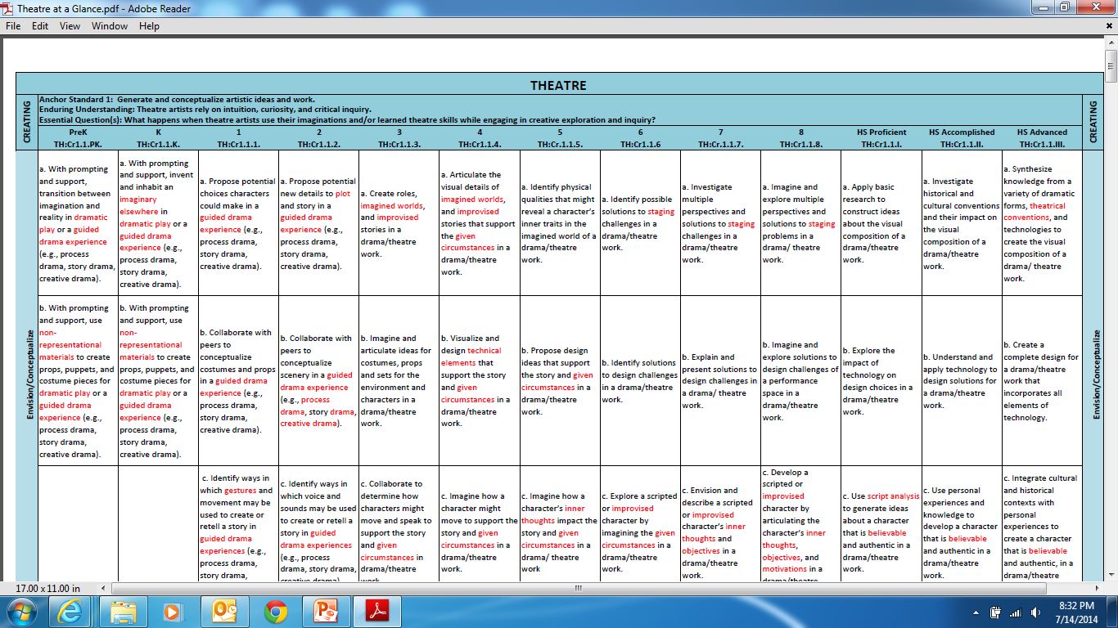

Slide 39
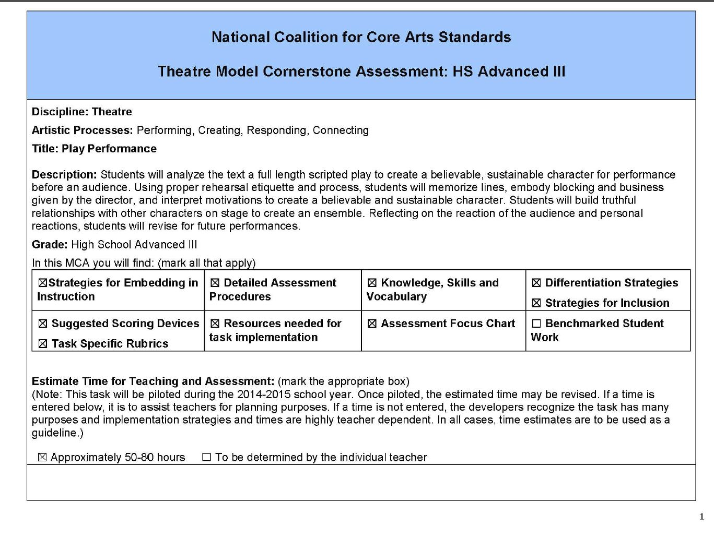

Model Cornerstone Assessments
Notes:
Draft Model Cornerstone Assessments, supplied for grades 2, 5, and 8, and for each high school proficiency level, are embedded in the standards site to provide tools teachers can adapt to document student growth and outcomes aligned with the new arts standards. These tasks are intended to serve as models to guide the development of local assessments and illustrate how student learning can be assessed through rich performance tasks with clearly identified criteria. These assessment tools will be piloted in classrooms across the U.S., eventually generating student work that will be posted on the NCAS website as “benchmarks” to illustrate the expectations of the standards. Teachers may adopt, adapt, or create their own MCAs as appropriate for their particular students and classrooms.

Slide 40
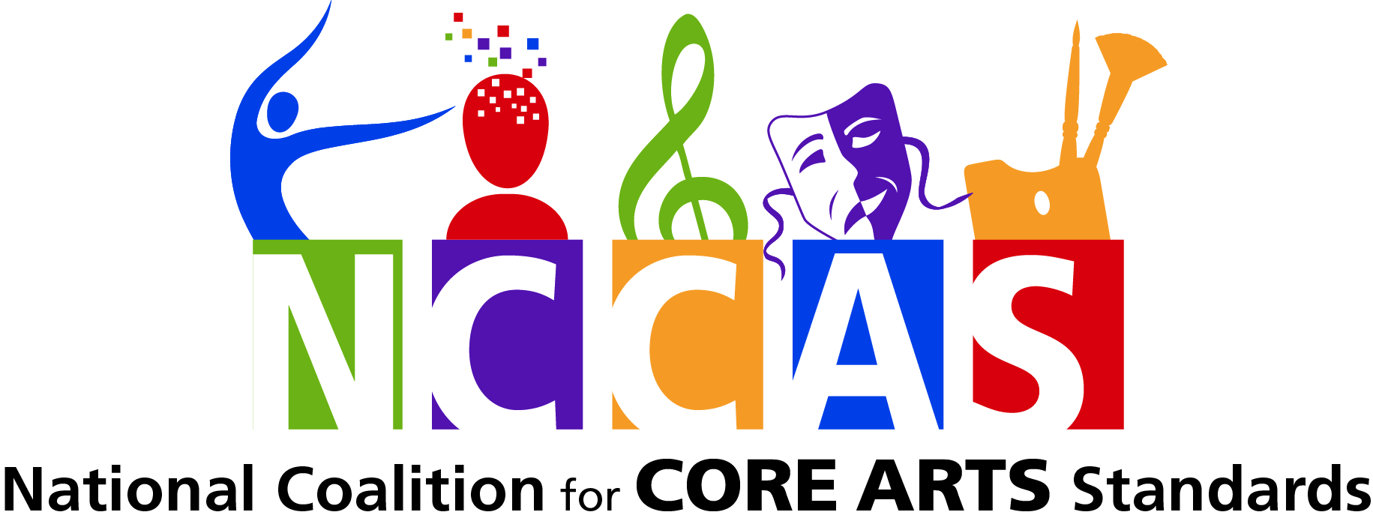
Web based home www.nationalartsstandards.org

Slide 41
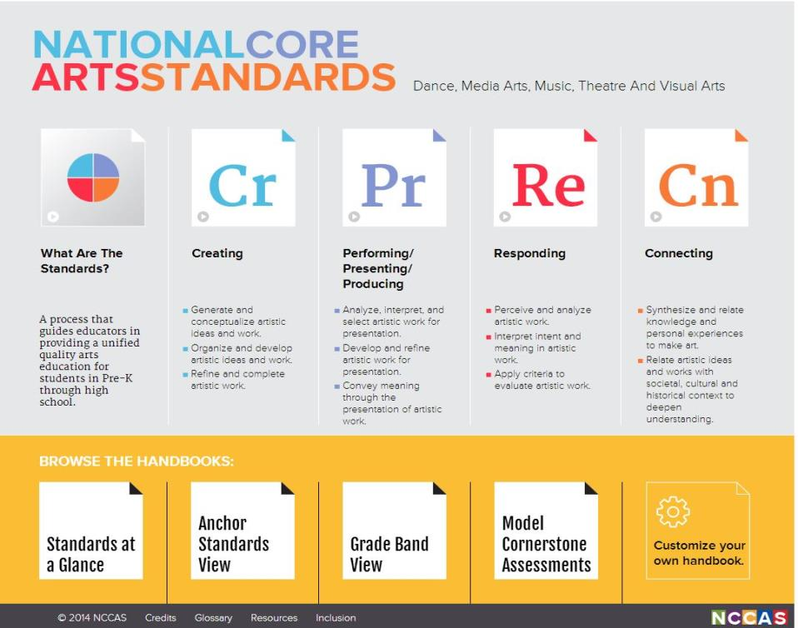
Notes:
Lets start with an overview. The website begins with the standards- and like the standards, we hope the website will be a process that guides and assists educators in providing a unified, quality standards arts education for students in Pre-K through High School.
The Core Arts Standards place artistic processes and anchor standards at the forefront of the work. Standards for all disciplines are organized through four artistic processes shown here- Creating, the Performing(Presenting, Producing), Responding and Connecting.
The Artistic Processes are the cognitive and physical actions by which arts learning and arts making are realized. Each of the arts disciplines incorporates these processes in some manner, and these define and organize the link between the art and the learner.
Each artistic process breaks into two or three anchor standards which parallel across all disciplines.
At the discipline level, these eleven anchor standards break down into discipline specific performance standards, which may be accessed grade by grade or by grade bands, depending on your need- several choices of handbooks which let you slice and dice the standards in ways that make sense to you.
Finally a resource section offers several useful tools to support you. Let’s dive a bit deeper into the resource section and see what’s there.

Slide 42
College Board Research
International Arts Education Standards: A Survey of the Arts Education Standards and Practices of Fifteen Countries and Regions
Arts Education Standards and 21st Century Skills
College Learning in the Arts
A Review of Selected State Arts Standards
Child Development and Arts Education: A review of Current Research and Best Practices
A Review of Connections between the Common Core State Standards and the Core Arts Standards
Notes:
In addition to the Conceptual Framework document, in the resource section you can find the College Board research studies that informed and drove the work of writing the standards.

Slide 43
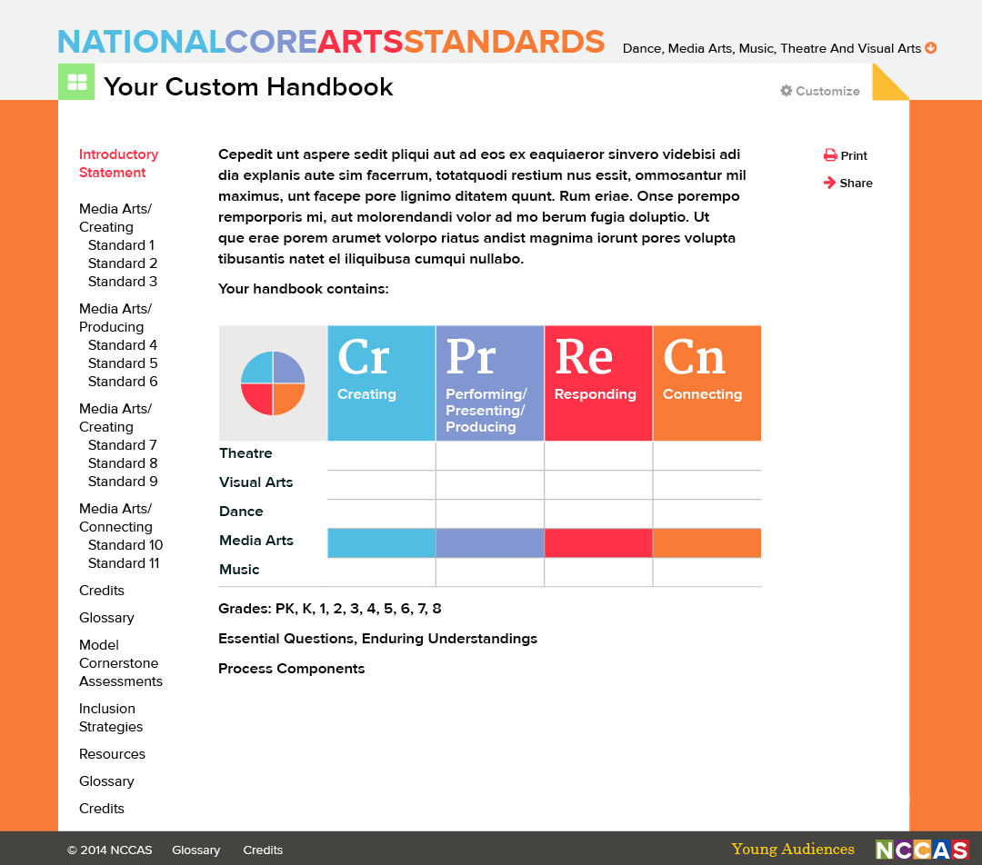

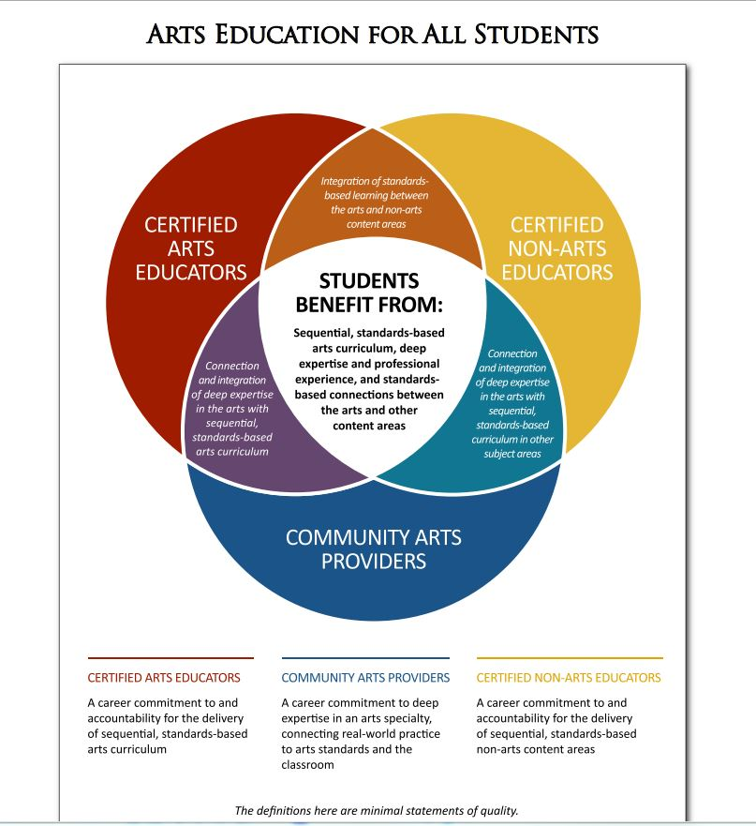
Resources
White papers
The College Board
Notes:
A library of white papers beginning with Arts Education for All: A Shared Endeavor

Slide 44
Notes:
There is also a specific section for Inclusion Guidelines for teaching all learners, authored for NCCAS by a dynamic team from the Kennedy Center Very Special Arts.

Slide 45
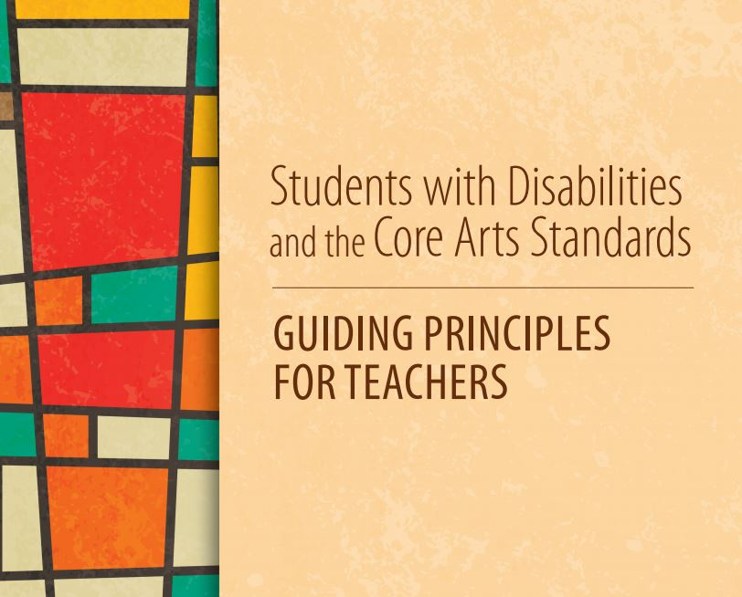
Resources
VSA
The International Organization on Arts and Disabilities - The Kennedy Center
Notes:
Resources for inclusion of students with disabilities- strategies for teaching all learners written for us by the Kennedy Center VSA team

Slide 46
Notes:
Examples of assessment – model cornerstone assessment s- unpack the standards further by showing what they might look like in a classroom .

Slide 47
Examples of Assessment

Slide 48

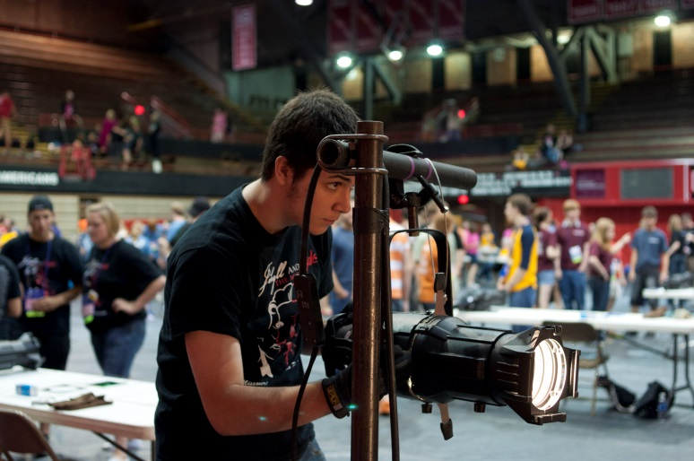
Model Cornerstone Assessments
at the benchmark grades of 2, 5, 8 and the three high school levels (proficient, accomplished, advanced) are examples of the type of evidence needed to show student achievement aligned to targeted performance standards.
They will be field tested and include:
assessment tools
differentiated learning strategies
benchmarked student work
Notes:
We hope teachers will borrow, steal, edit and use these MCA’s by making them their own. These are only example snapshots of a moment in time imagined by the writers- read educators will bring them to life and test them in the classrooms to provide samples of student work. MCA’s are being piloted beginning with the 2014-2015 school year.

Slide 49
Viewing, downloading or printing out the standards www.nationalartsstandards.org

Slide 50
Notes:
You can use them directly from the website or you can create and choose the way you wish to view the standards, download them to your computer and save, print or share them.
There are two ways to download, save and print. The first is by clicking on “standards at a glance”

Slide 51
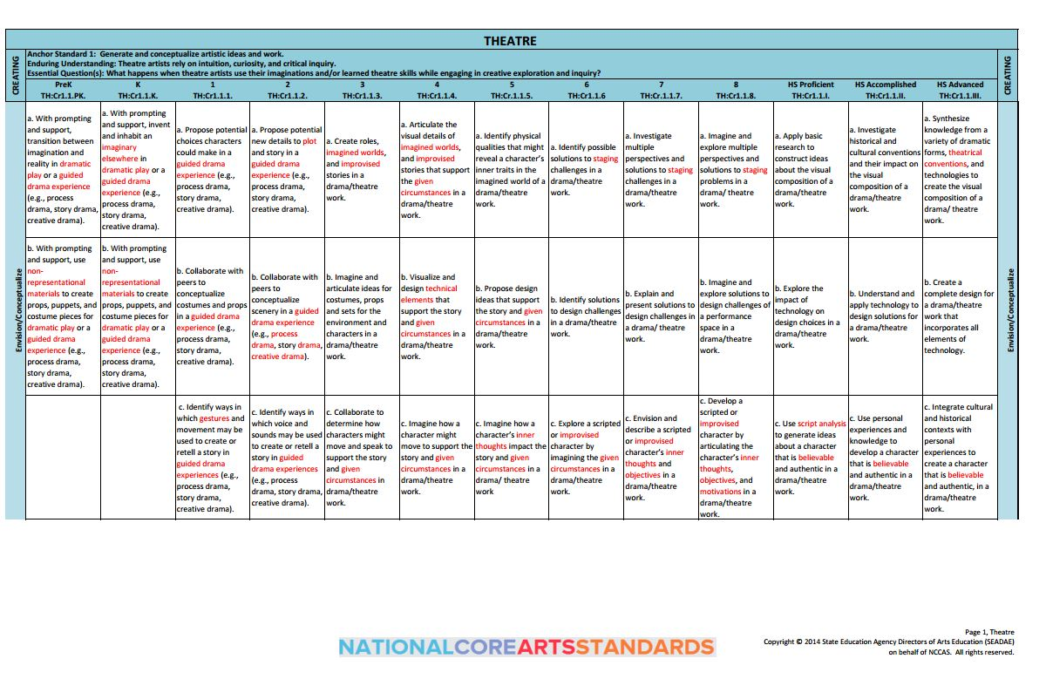
Standards at a Glance
Prints out as 11 x 17 – check your printer settings
Notes:
Standards at a Glance view will let you print out the standards in a spreadsheet similar to this poster view. This is the quick and easy view that shows you all of the standards in a discipline in one 11 x 17 size view from grades Pre K – 12.

Slide 52
Notes:
“Customize your handbook” lets you create and print a pdf standards handbook that is customized to your needs .

Slide 53
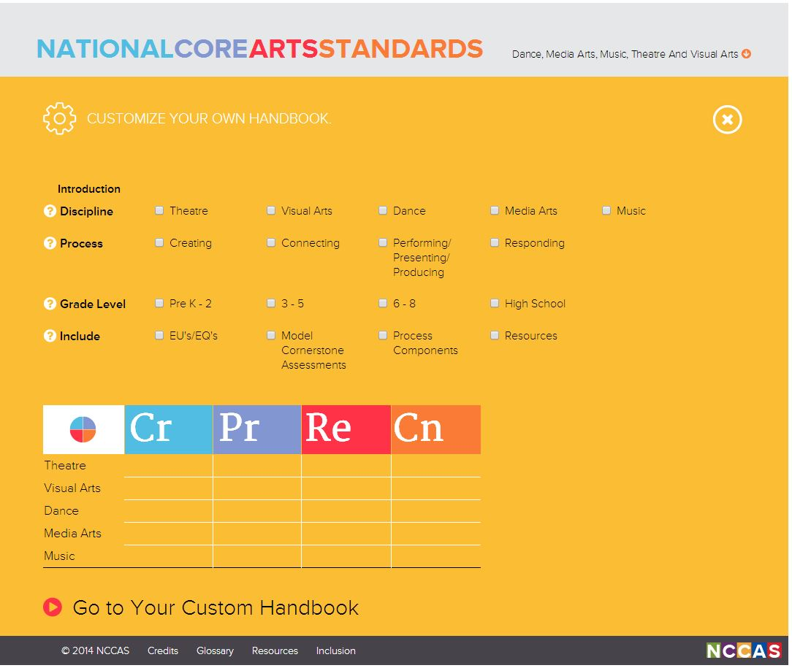
Notes:
You’ll notice that you may search by Discipline - Artistic Process or Grade Level (choose grade band or click on one for the grade by grade
drop down menu)
You may choose from several instructional support materials to include- Enduring Understandings and Essential Questions, Model Cornerstone Assessments, Process Components and discipline specific resources
As you choose an item- the interactive index lights up creating a custom breadcrumb trail to show you what you are putting in your shopping cart to build your custom handbook
Once you have completed your choices, just click “Go to Custom Handbook” to create your own custom view of the Standards and support materials, download it, print or share it.

Slide 54
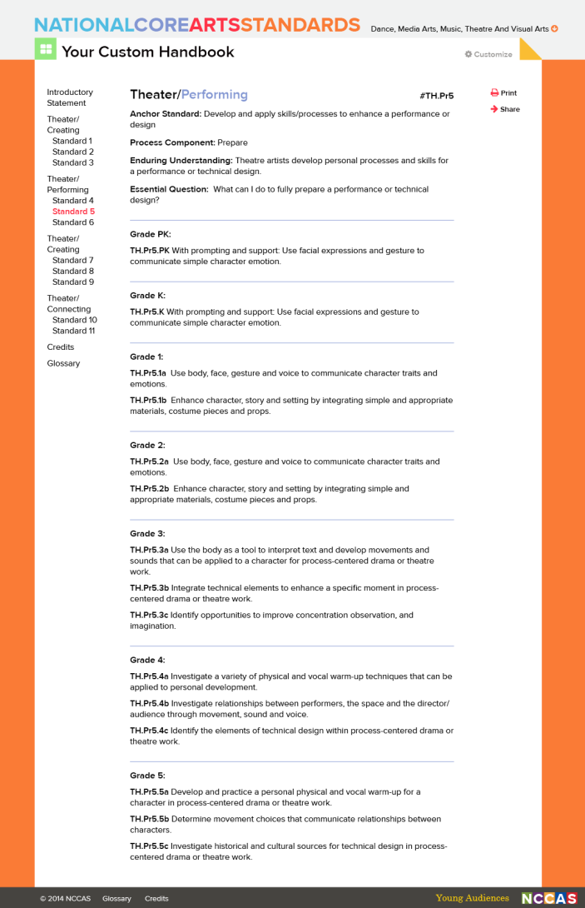
Notes:
Here is an example showing what a custom handbook looks like. Notice how the clickable index at the left allows you to jump through the document. Use the “print” button at the top right to download and print your handbook.
Best yet- educators may share this set of standards with their principal, fellow teachers, students, parents- just by clicking the share button at the top of the page to email the custom handbook to the persons of their choosing.

Slide 55
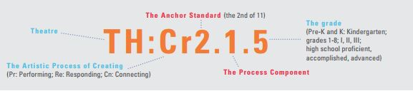
Standards numbering system
Notes:
The standards numbering system is a breadcrumb trail to help you keep track of where you are.

Slide 56
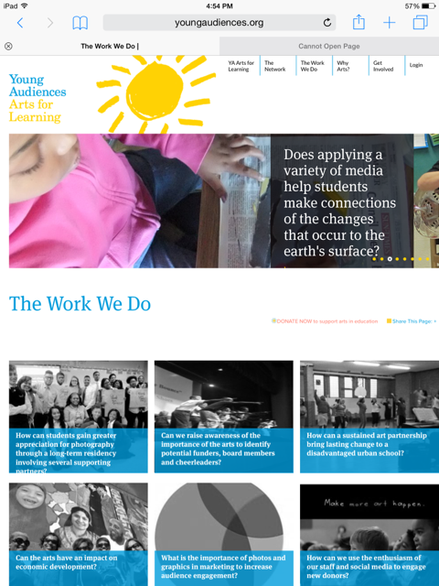
Young Audience
case studies.....

Slide 57
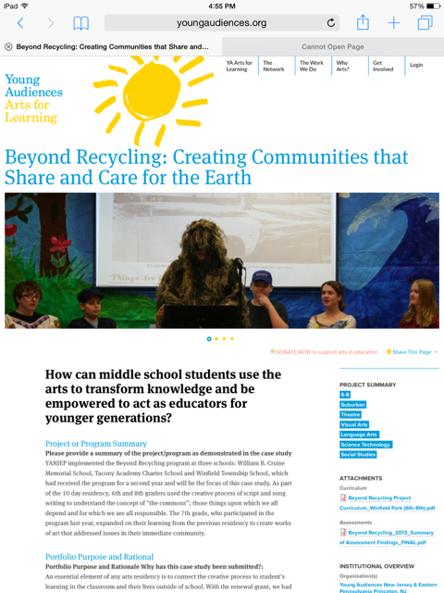
...standards in
action!

Slide 58
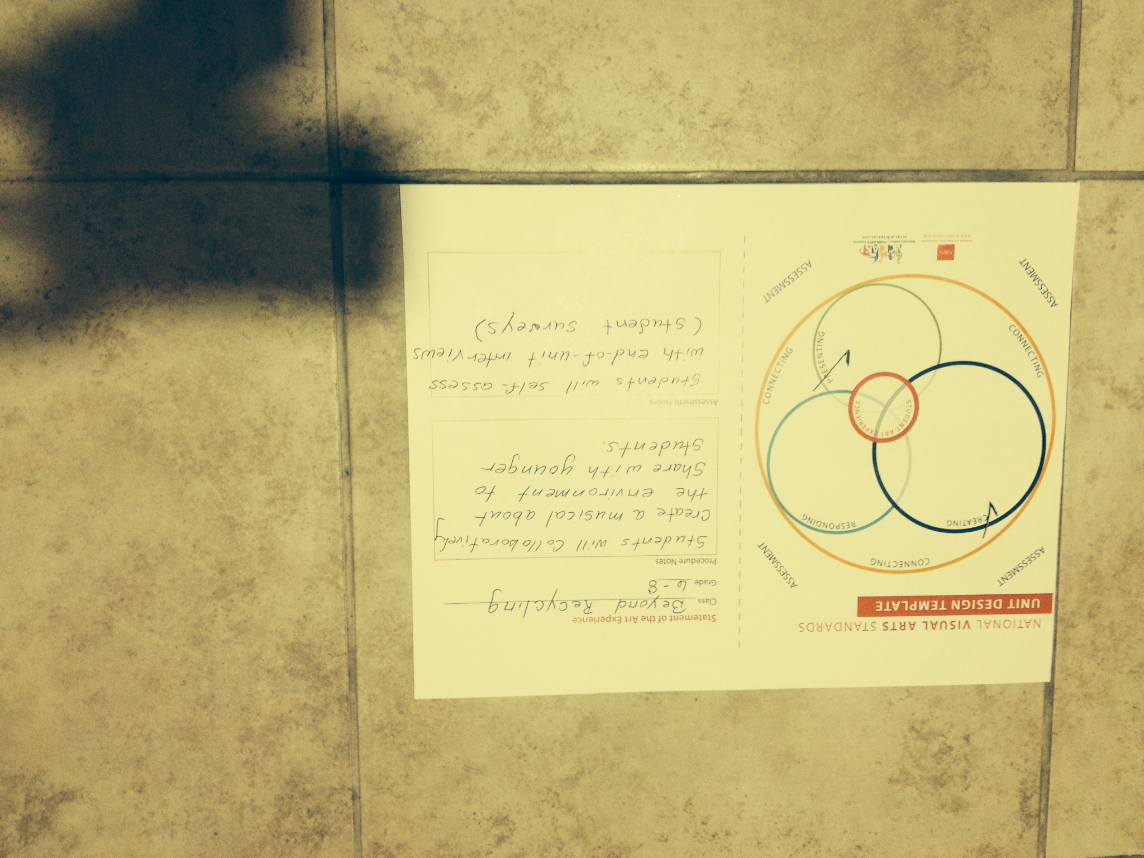

Slide 59
Web based home www.nationalartsstandards.org http://nccas.wikispaces.com

