Slide 1

Colorado Visual and Performing Arts Education Survey
Young Audiences National Conference 2015
Notes:
In 2006-2008 several states began an “inventory” of arts education in their states. That is, they surveyed schools to ascertain the amount and typology of arts education offered and at what grade level. Further, the surveys looked at what kind of training teachers delivering arts classes had. Some studies used a stratified random sample methodology (Stratified sampling is a probability sampling technique wherein the researcher divides the entire population into different subgroups or strata, then randomly selects the final subjects proportionally from the different strata. Such as rural schools vs. urban schools, but no cross over can exist between the different strata’s), and some used a population sample methodology (all schools were invited to be part of the study)

Slide 2

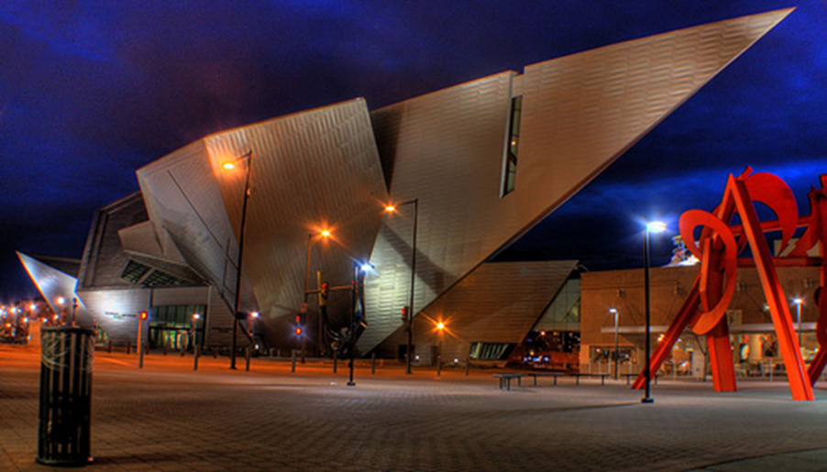
Colorado 2014 Data
Strata | Total | Survey | Response rate
Elementary | 1041 | 295 | 28%
Middle | 419 | 192 | 46%
High School | 379 | 138 | 36%
Total | 1839 | 625
Denver Art Museum, Denver, CO
2008 Survey had a 25% response rate
2014 Survey had a 34% response rate
Notes:
Colorado’s first arts education study was conducted by Colorado Creative Industries (then Colorado Council on the Arts) in cooperation with the Colorado Department of Education and used population methodology. Data was collected from December 2007-February 2008. The survey had a 25% response rate from Colorado K-12 public schools.
Several states have conducted surveys: AEP lists all State Arts studies

Slide 3
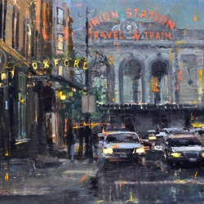
Colorado Visual and Performing Arts Education Survey
The Message:
Colorado has mainly “held its own” with arts education since 2008
Data “mirrors” several 2008 trend lines, including the relative amounts of arts education received by grade level
Strong support for the value of arts education evidenced by the principals who completed the survey
Colorado Artist: James Beckner
Notes:
In 2014 Colorado Creative Industries initiated a second iteration of the first study. For the 2014 study CCI invited several external providers (including Think 360 Arts for Learning) to be part of the advisory process to the work in addition to the leadership of the arts education discipline organizations (CMEA, CAAE, etc.). Members of this group all reviewed the survey instrument and made suggestions for possible additional questions to be posed of principals.
It was desirable to preserve the same questions in the 2014 work as the 2008 study for continuity; however, questions were added that relate to external providers. The involvement of trusted external providers assured that these questions would be posed. HERE make a point that YA affiliates need to get their oar in the water to ensure pertinent questions about external providers are included! Those questions will be included in the 2014 survey data to follow.
Leadership of external provider organizations as well as leadership of arts education discipline organizations were enlisted to finalize the survey.
The survey was launched in April 2014 – through electronic notification of principals using lists from the Colorado Association of School Executives (CASE); the rationale for using a third party for notification was to ensure that the survey would not be viewed as self-serving by either the Colorado Creative Industries division, nor the Colorado Department of Education.

Slide 4
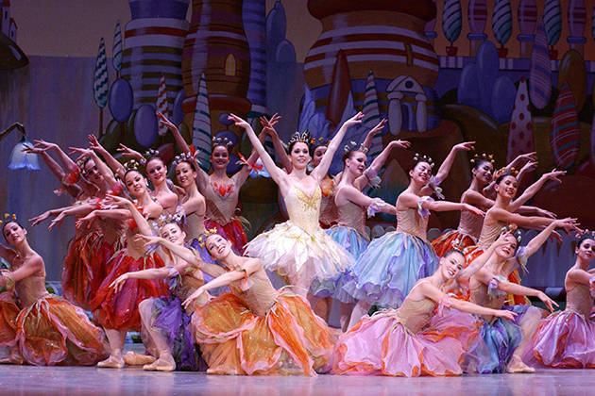
Colorado Visual and Performing Arts Education Survey
Observable Trends:
98% of Elementary students receiving some art - music and visual arts, approximately 118 minutes per week.
71% of Middle School students receiving some art - offerings are more varied.
54% of High School students receiving some art, with even more varied offerings.
“Nutcracker” Colorado Ballet
Notes:
Final data was collected end of December 2014.
From there the data was cleaned and analyzed. Several outlier responses were checked for accuracy, and some surveys were rejected as too incomplete. A few were rejected due to no identifying information (no school name and no way to drill down to that information).

Slide 5
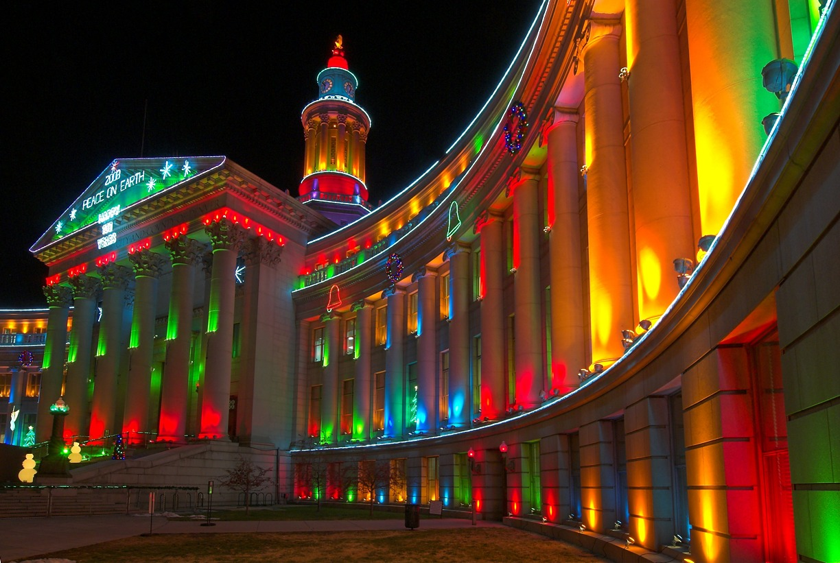
Colorado Visual and Performing Arts Education Survey
Trends by External Providers:
Approximately 35% of CO schools reach out for resources outside the school and school district.
Approximately 35% of CO schools receive services from cultural external providers (these two factors likely influence each other)
Civic Center Building, Denver, Colorado

Slide 6
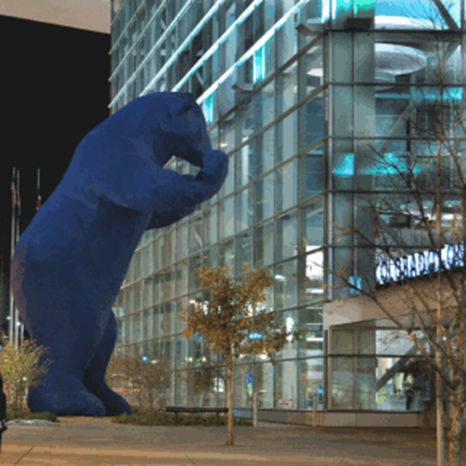

Colorado Visual and Performing Arts Education Survey
Trends about External Providers:
Barriers to these relationships and services cited as;
budget (54%)
    time (54%)
    lack of information (53%)
    other (17%)
Most common “other” barriers cited, remote location of school and difficulty traveling to arts organizations and institutions

Slide 7

Colorado Visual and Performing Arts Education Survey
Survey Results:
97% of Colorado schools provide some formal arts education
2% of Colorado schools do not provide any formal arts education
1% of respondents not sure
Approximately 28,150 Colorado public school children attend schools which do not offer any formal arts education
Civic Center Park, CO State Capitol
Notes:
The “messaging” of the survey was addressed by an advisory group comprised of educators, external providers, and education policy advisors. The consensus of the group was the following message:
Overall Colorado has “held the line” on arts education since 2008 (this despite the Great Recession and its aftermath)
There are some encouraging upticks with % of schools engaging in relationships with external providers, albeit this remains an area of challenge and also opportunity
Educators and building leadership support arts education and believe in its value
Elementary and middle schools have breadth of exposure but little depth
High School has the option for depth but far too many students get even a little exposure
There is a resilient foundation in Colorado for arts education on which to build
We appear to have a version of the “Colorado paradox” in arts education – that is, we are growing and touting our creative employers and jobs, but not adequately educating our students to assume these positions. The “Colorado paradox” refers to the high percentage of very educated populace, and yet our own HS graduation rates are dismal.
Albeit we would have loved 100% response rate, all things considered, it is encouraging that so many schools participated.

Slide 8
Colorado Visual and Performing Arts Education Survey
Music
Visual arts
Theater
Dance
At every grade level, the majority of elementary schools offer Visual Arts and/or Music. Theater and Dance are offered far less.
Notes:
A series of convenings of arts education leaders ensured in which the data was presented for reasonability. A notable issue: several dance education leaders questioned the statistics on dance education at the elementary level. One leader wrote “I’m afraid principals may be counting as dance a unit of PE that focuses on dance” Future surveys will clarify what exactly constitutes dance education.

Slide 9
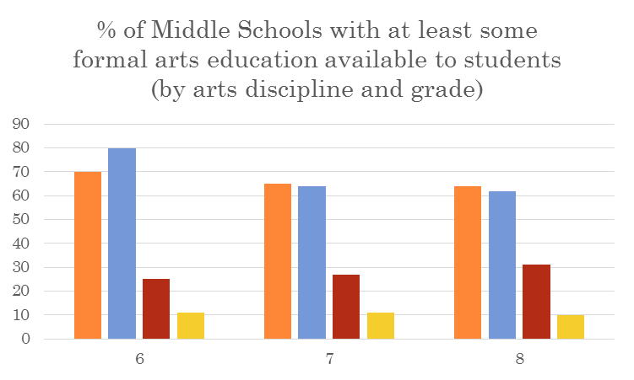
Colorado Visual and Performing Arts Education Survey
Visual Arts
Music
Theatre
Dance
Likewise, while the majority of middle schools offer at least some formal arts education, the focus is on Visual Arts and Music, as opposed to Theater and Dance.
Notes:
The advisory committee as well recommended the following:
That we must have an annual, 100% of CO K-12 public schools census of arts education (using questions similar to those in this 2014 study)
Further, that the results of such census be transparent and public, and readily available.
Further, that there be a coalition of interested and invested stakeholders developed to create this arts education census – think beyond the arts to social studies, PE, science – are there allies in those fields who are facing similar issues and would be willing partners in efforts to collect our respective education fields’ data regularly and efficiently
A creative metaphor was raised – a local bird observatory has an annual “bird watch” day – the idea being that there be an annual “arts education count” day in which principals/educators fill out the survey, and there is increased arts education activity during and after the school day to celebrate the census.
Research how New Jersey has accomplished their annual arts education census (now mandated in all schools - and NJ is the first state to mandate)
Develop resources for this arts education census – neither Colorado Creative Industries nor Colorado Dept. of Education have the resources to do this –

Slide 10
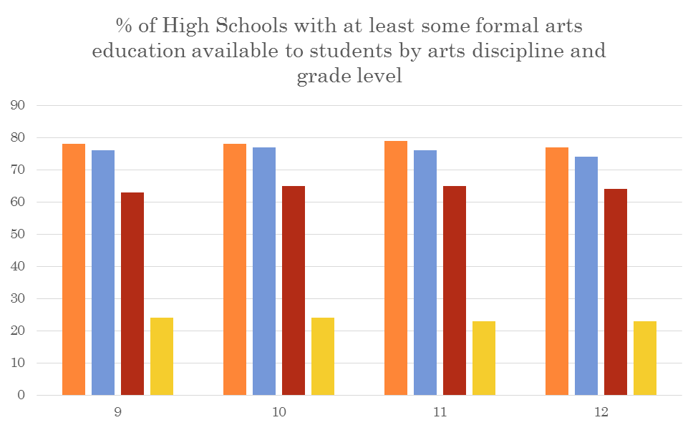


Colorado Visual and Performing Arts Education Survey
Colorado State flag
At the high school level we saw much more inclusion of Theater in arts education. Dance as an offering was also more common at the high school grades than the lower grades, but not nearly as common as the other three art disciplines.

Slide 11
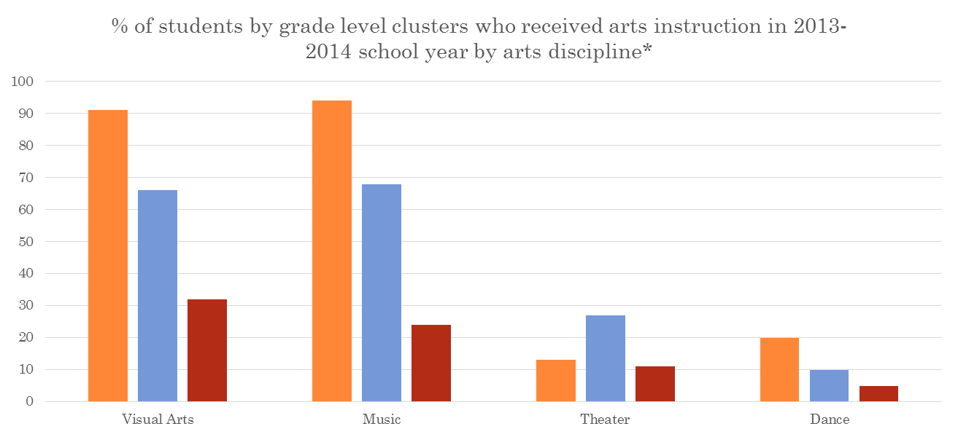
Colorado Visual and Performing Arts Education Survey
Grades K-5
Grades 6-8
Grades 9-12
A great majority of elementary school students received Visual Arts and/or Music in the 2013-2014 school year. Two-thirds of middle school students received instruction in those disciplines. For all grade levels, a minority of students received instruction in Theater Arts and/or Dance.
*Summed scores for all responding schools which provided discipline detail

Slide 12
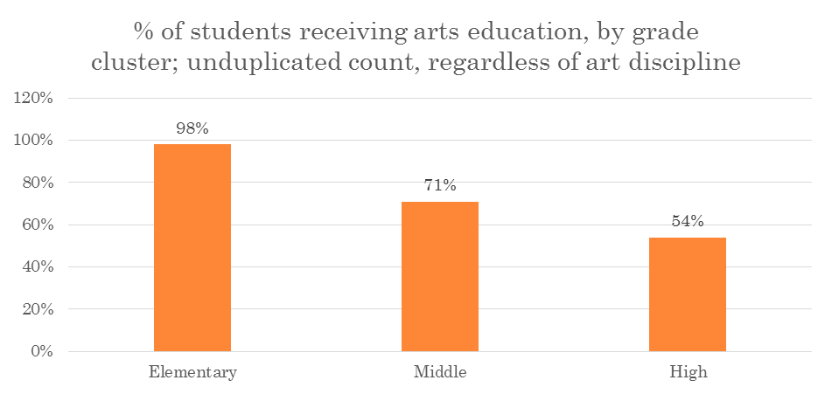
Colorado Visual and Performing Arts Education Survey
These percentages contrast with the 2008 study, when 94% of Elementary School students, 66% of Middle School students, and 47% of High School students received at least some formal arts education, showing an increase at all grade levels.
Notes:
Examining unduplicated counts of students obtaining at least some formal arts education, we see that, proportionately, elementary students are more commonly receiving arts education than both middle school students (71%) and high school students (54%). This is not surprising, as students at higher grade levels often have discretion in which courses they take.

Slide 13

Colorado Visual and Performing Arts Education Survey
Instruction Time Per Week:
How many minutes per day do your students receive instruction (all academic disciplines, not just art)?
Colorado K-12 schools provide 359 minutes of instruction per day.

Slide 14

Colorado Visual and Performing Arts Education Survey
For students who receive art instruction (any arts discipline), how many minutes do they receive each week?
Denver Skyline, CO 2014

Slide 15

Colorado Visual and Performing Arts Education Survey
Minutes of Elementary School Arts Instruction
60 minutes or less | 25% (20% 2008)
61 to 120 minutes | 39% (30% 2008)
121 to 180 minutes | 21% (30% 2008)
181 minutes or more | 15% (20% 2008)
Colorado State Capitol

Slide 16

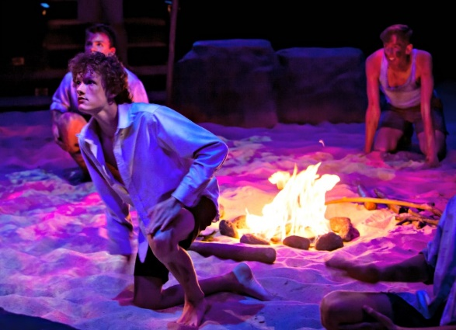
Colorado Visual and Performing Arts Education Survey
On average Colorado Elementary students are receiving 118 minutes of formal arts education per week, down from 120 minutes in 2008.
In 2014 more students are receiving either 60 minutes or less or from 61-120 minutes per week.
“Lord of the Flies” 2014 Season

Slide 17
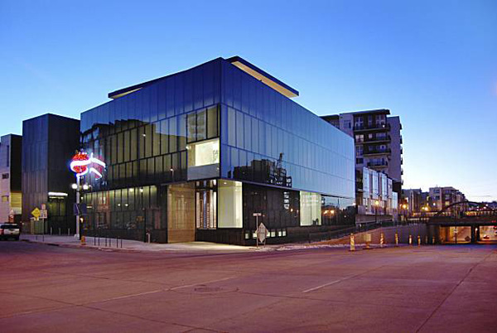
Colorado Visual and Performing Arts Education Survey
Grade Point Average Inclusion:
Is student performance in arts classes used in the calculation
of grade point average or class rank?
Yes: 77%
No: 17%
Don’t know: 6%
Museum of Contemporary Art, Denver, CO

Slide 18
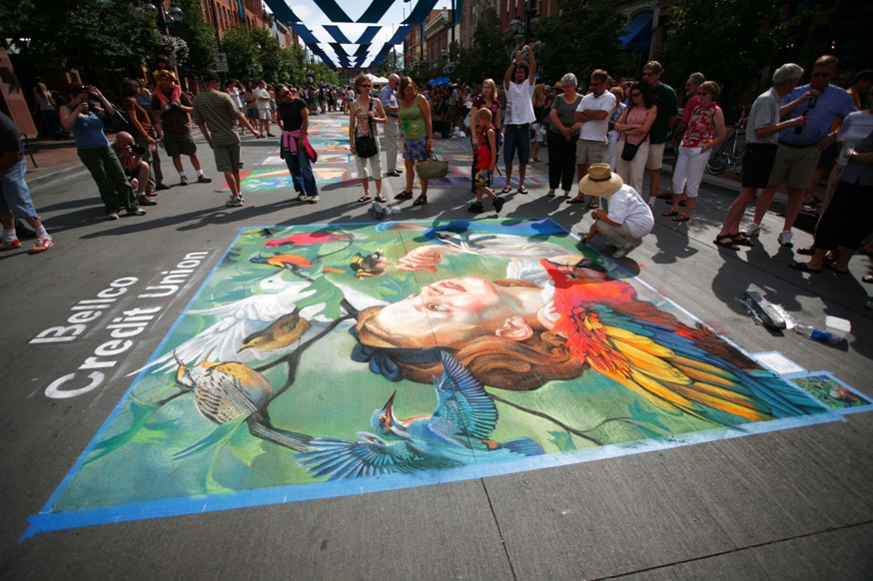
Colorado Visual and Performing Arts Education Survey
Graduation Requirement Inclusion:
What are the local graduation requirements for the arts?
1-2 credits: 67%
0 credits: 30%
Don’t know: 3%
Chalk Drawings, Larimer Square, Denver, CO

Slide 19
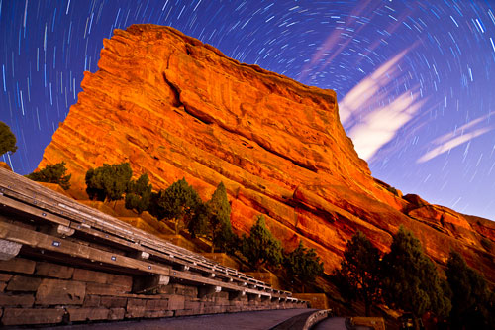
Colorado Visual and Performing Arts Education Survey
Funding:
How would you describe the total budget allocation for arts education in your school compared to 6 years ago? Would you say it has increased, decreased, or stayed about the same?
Red Rocks Amphitheatre, CO

Slide 20
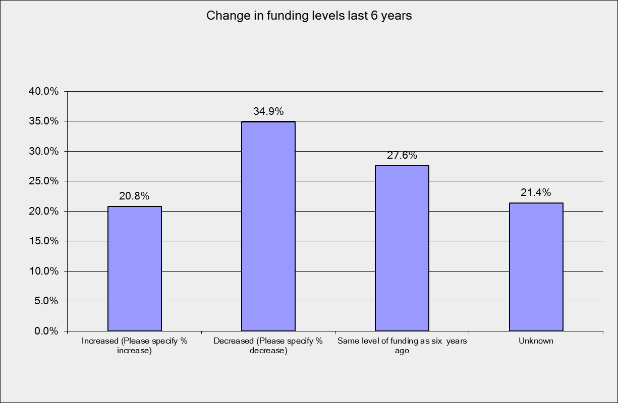
Colorado Visual and Performing Arts Education Survey

Slide 21
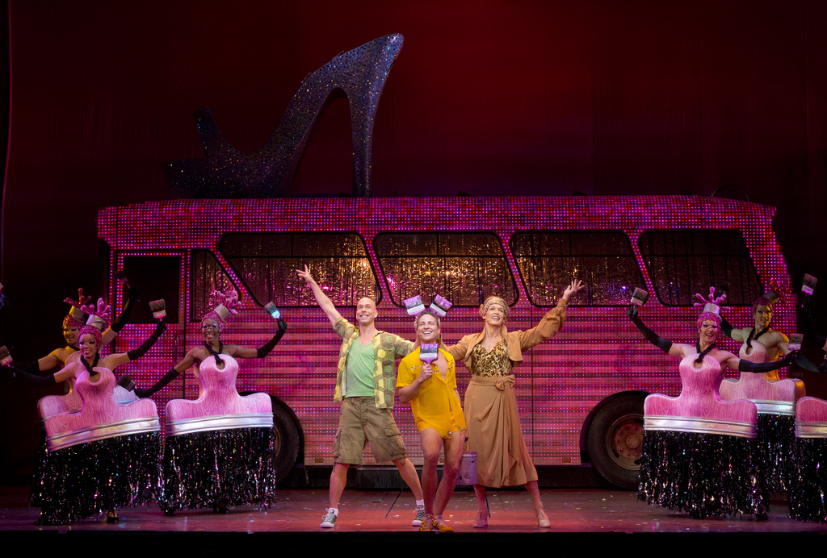

Colorado Visual and Performing Arts Education Survey
Outside Funding:
In the previous school year, did your school receive funding from a source outside of the school district to support arts education?
Yes 35%
No 65%
“Priscilla – Queen of the Desert”

Slide 22
Colorado Visual and Performing Arts Education Survey
Use of external sources of arts education enhancement activities: student participation | 2014 | 2008
Received instruction from a visiting artist – elementary | 42% | 37%
Received instruction from a visiting artist – middle school | 40% | 40%
Received instruction from a visiting artist - high school | 46% | 42%
Elementary field trips to arts organizations or institutions | 60% | 64%
Middle school field trips to arts organizations or institutions | 47% | 55%
High school field trips to arts organizations or institutions | 47% | 43%

Slide 23
Colorado Visual and Performing Arts Education Survey
Use of external sources of arts education enhancement activities: student participation (continued) | 2014 | 2008
Elementary participated in arts-related assemblies | 58% | 67%
Middle schools participated in arts-related assemblies | 53% | 67%
High schools participated in arts-related assemblies | 51% | 81%
None of the above – elementary school | 10% | 17%
None of the above – middle school | 18% | 20%
None of the above – high school | 21% | 16%

Slide 24

Colorado Visual and Performing Arts Education Survey
External provider relationships:
Does your school have a relationship with one or more external provider?
 | 2014 | 2008
Elementary Schools | 34% | 26%
Middle Schools | 30% | 24%
High Schools | 28% | 24%
The Santa Fe Art District, Denver, CO

Slide 25

External provider relationships cont’d:
If yes, how was that partnership initiated?
 | 2014
Teachers | 72%
Principals | 45%
Parents and parent associations | 45%
Outreach from cultural organization | 40%
Gunnison, CO

Slide 26

Colorado Visual and Performing Arts Education Survey
If you do not have relationships with external providers, what are the barriers?
Wilson Peak, CO
 | 2014
Budget constraints | 54%
Time constraints | 54%
Lack of information about external providers | 53%
Other: remote location of school and difficulty of traveling to arts organizations and institutions | 17%

Slide 27
Colorado Visual and Performing Arts Education Survey
Reviewing the known and unknown intrinsic power of arts education: 1 = Completely Disagree and 5 = Completely Agree | 2014
Students-at-risk are less likely to drop out of school if arts instruction is available at their school. | 4.33
Art instruction helps to better prepare students for future education and/or the work world. | 4.44
Art instruction helps students do better in academic disciplines. | 4.5
The content taught in an art class is an important part of a quality public education experience. | 4.66
Arts programming enhances parental involvement in our school. | 4.06
Access to knowledge about careers in creative industries could provide increased motivation to provide arts instruction. | 4.16

Slide 28

Conclusions
These studies, ‘08 and ‘14 measure inputs, and trends are stable.
More resources needed to collect this type of data on a regular basis, consistently across all 178 Colorado school districts.
Only when arts education data is collected regularly and consistently will it be possible to apply inferential methods in order to develop plausible correlations with other elements of public education.
Each state has its own conditions to consider in conducting this kind of research. For example, Colorado is one of 6 states that are considered “local control,” which means each of Colorado’s 178 school districts has wide curriculum purview.

Slide 29

Questions about research and/or discussion questions:
  Are other YA affiliates involved in their states’ arts education research?
  Is there general awareness in YA affiliate states about whether their state collects this data or not?
  How might arts education data
  impact YA affiliates?
  Other?

Slide 30

Colorado Visual and Performing Arts Education Survey
Denver City Park, Colorado

