Slide 1
Embedded professional development
revolutionary residencies
Welcome!
We want to understand what you know and want to know about embedded professional development.
Feel free to saunter around the room, meet some new/old friends, and discuss the topics around the room. Please record thoughts, ideas, questions on the paper.

Slide 2
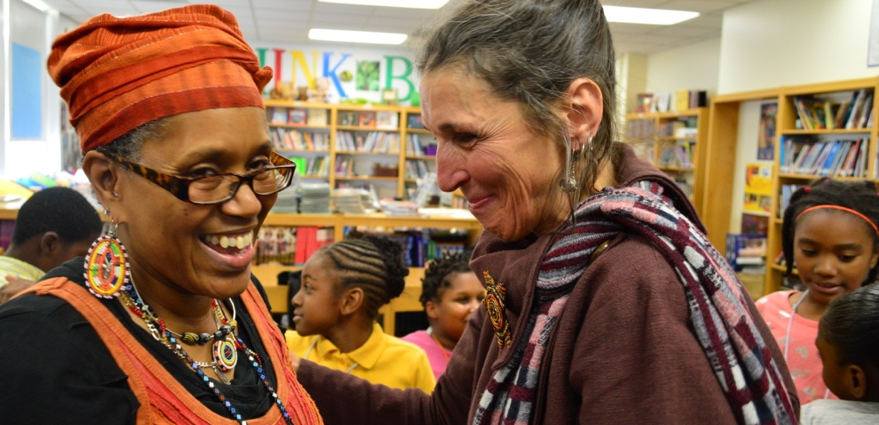
Embedded professional development
revolutionary residencies

Slide 3
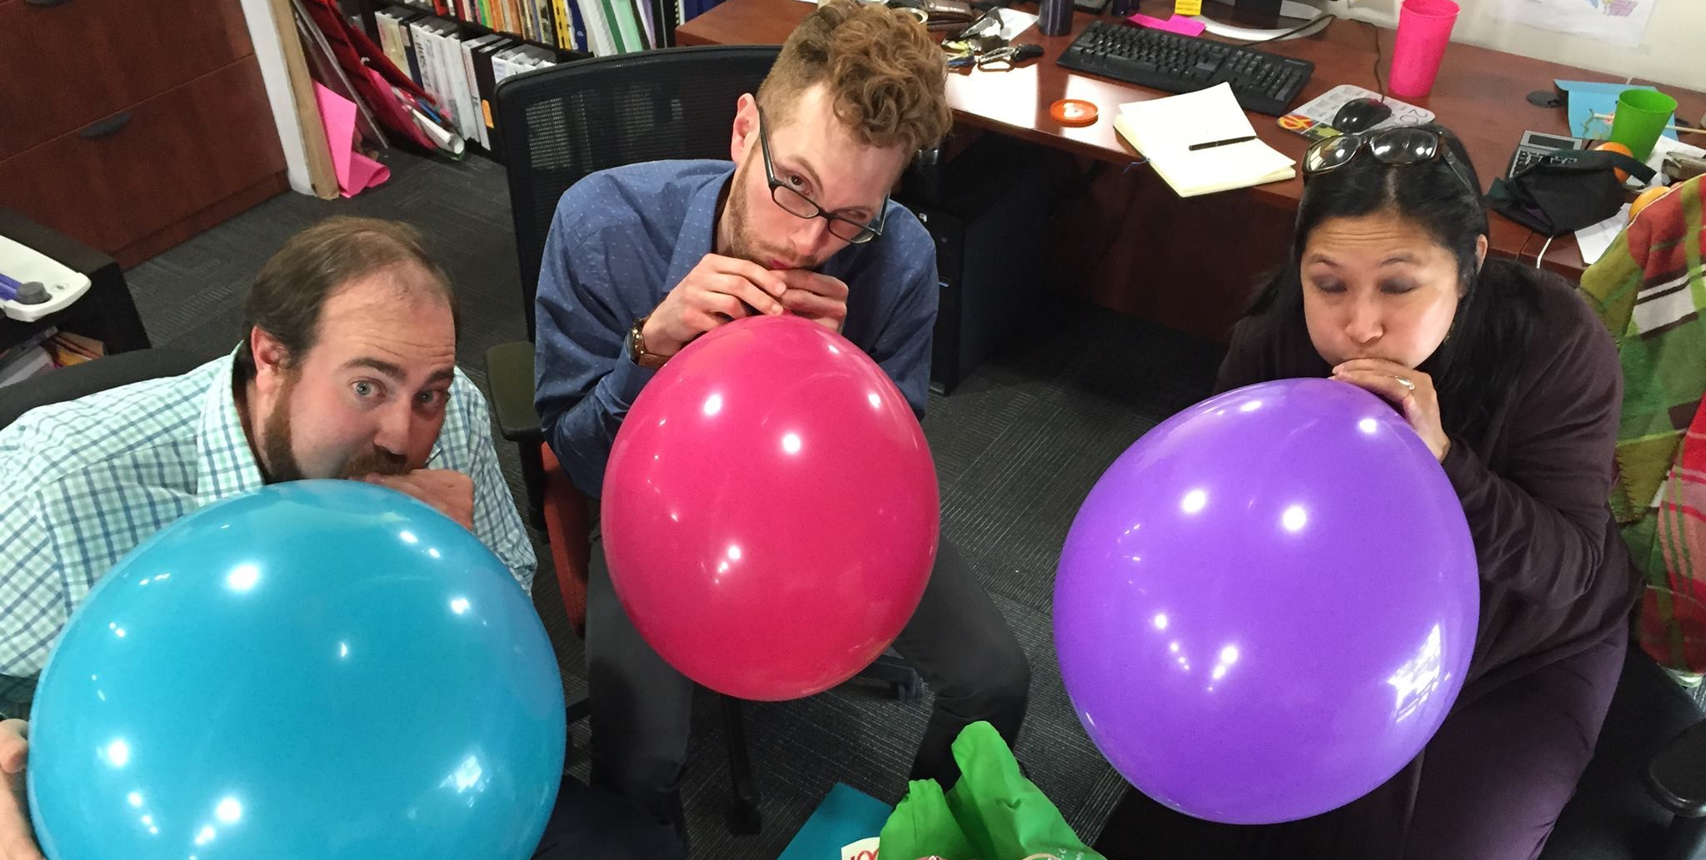
World cafe
Benefits challenges experiences questions

Slide 4
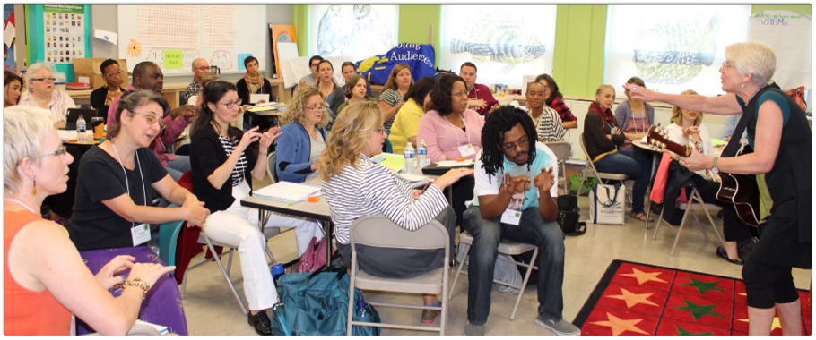
Story time
How we evolved
Residency > pd > district pd > smart

Slide 5
If you build it they will come
Training for teaching artists = sneaky way to get teachers to understand the power of bringing artists into the classroom.
Artists & Teachers work collaboratively to design a residency aligned with common core standards
Field tested with entire grade level
Funded by schools, artists fees, & fundraising

Slide 6
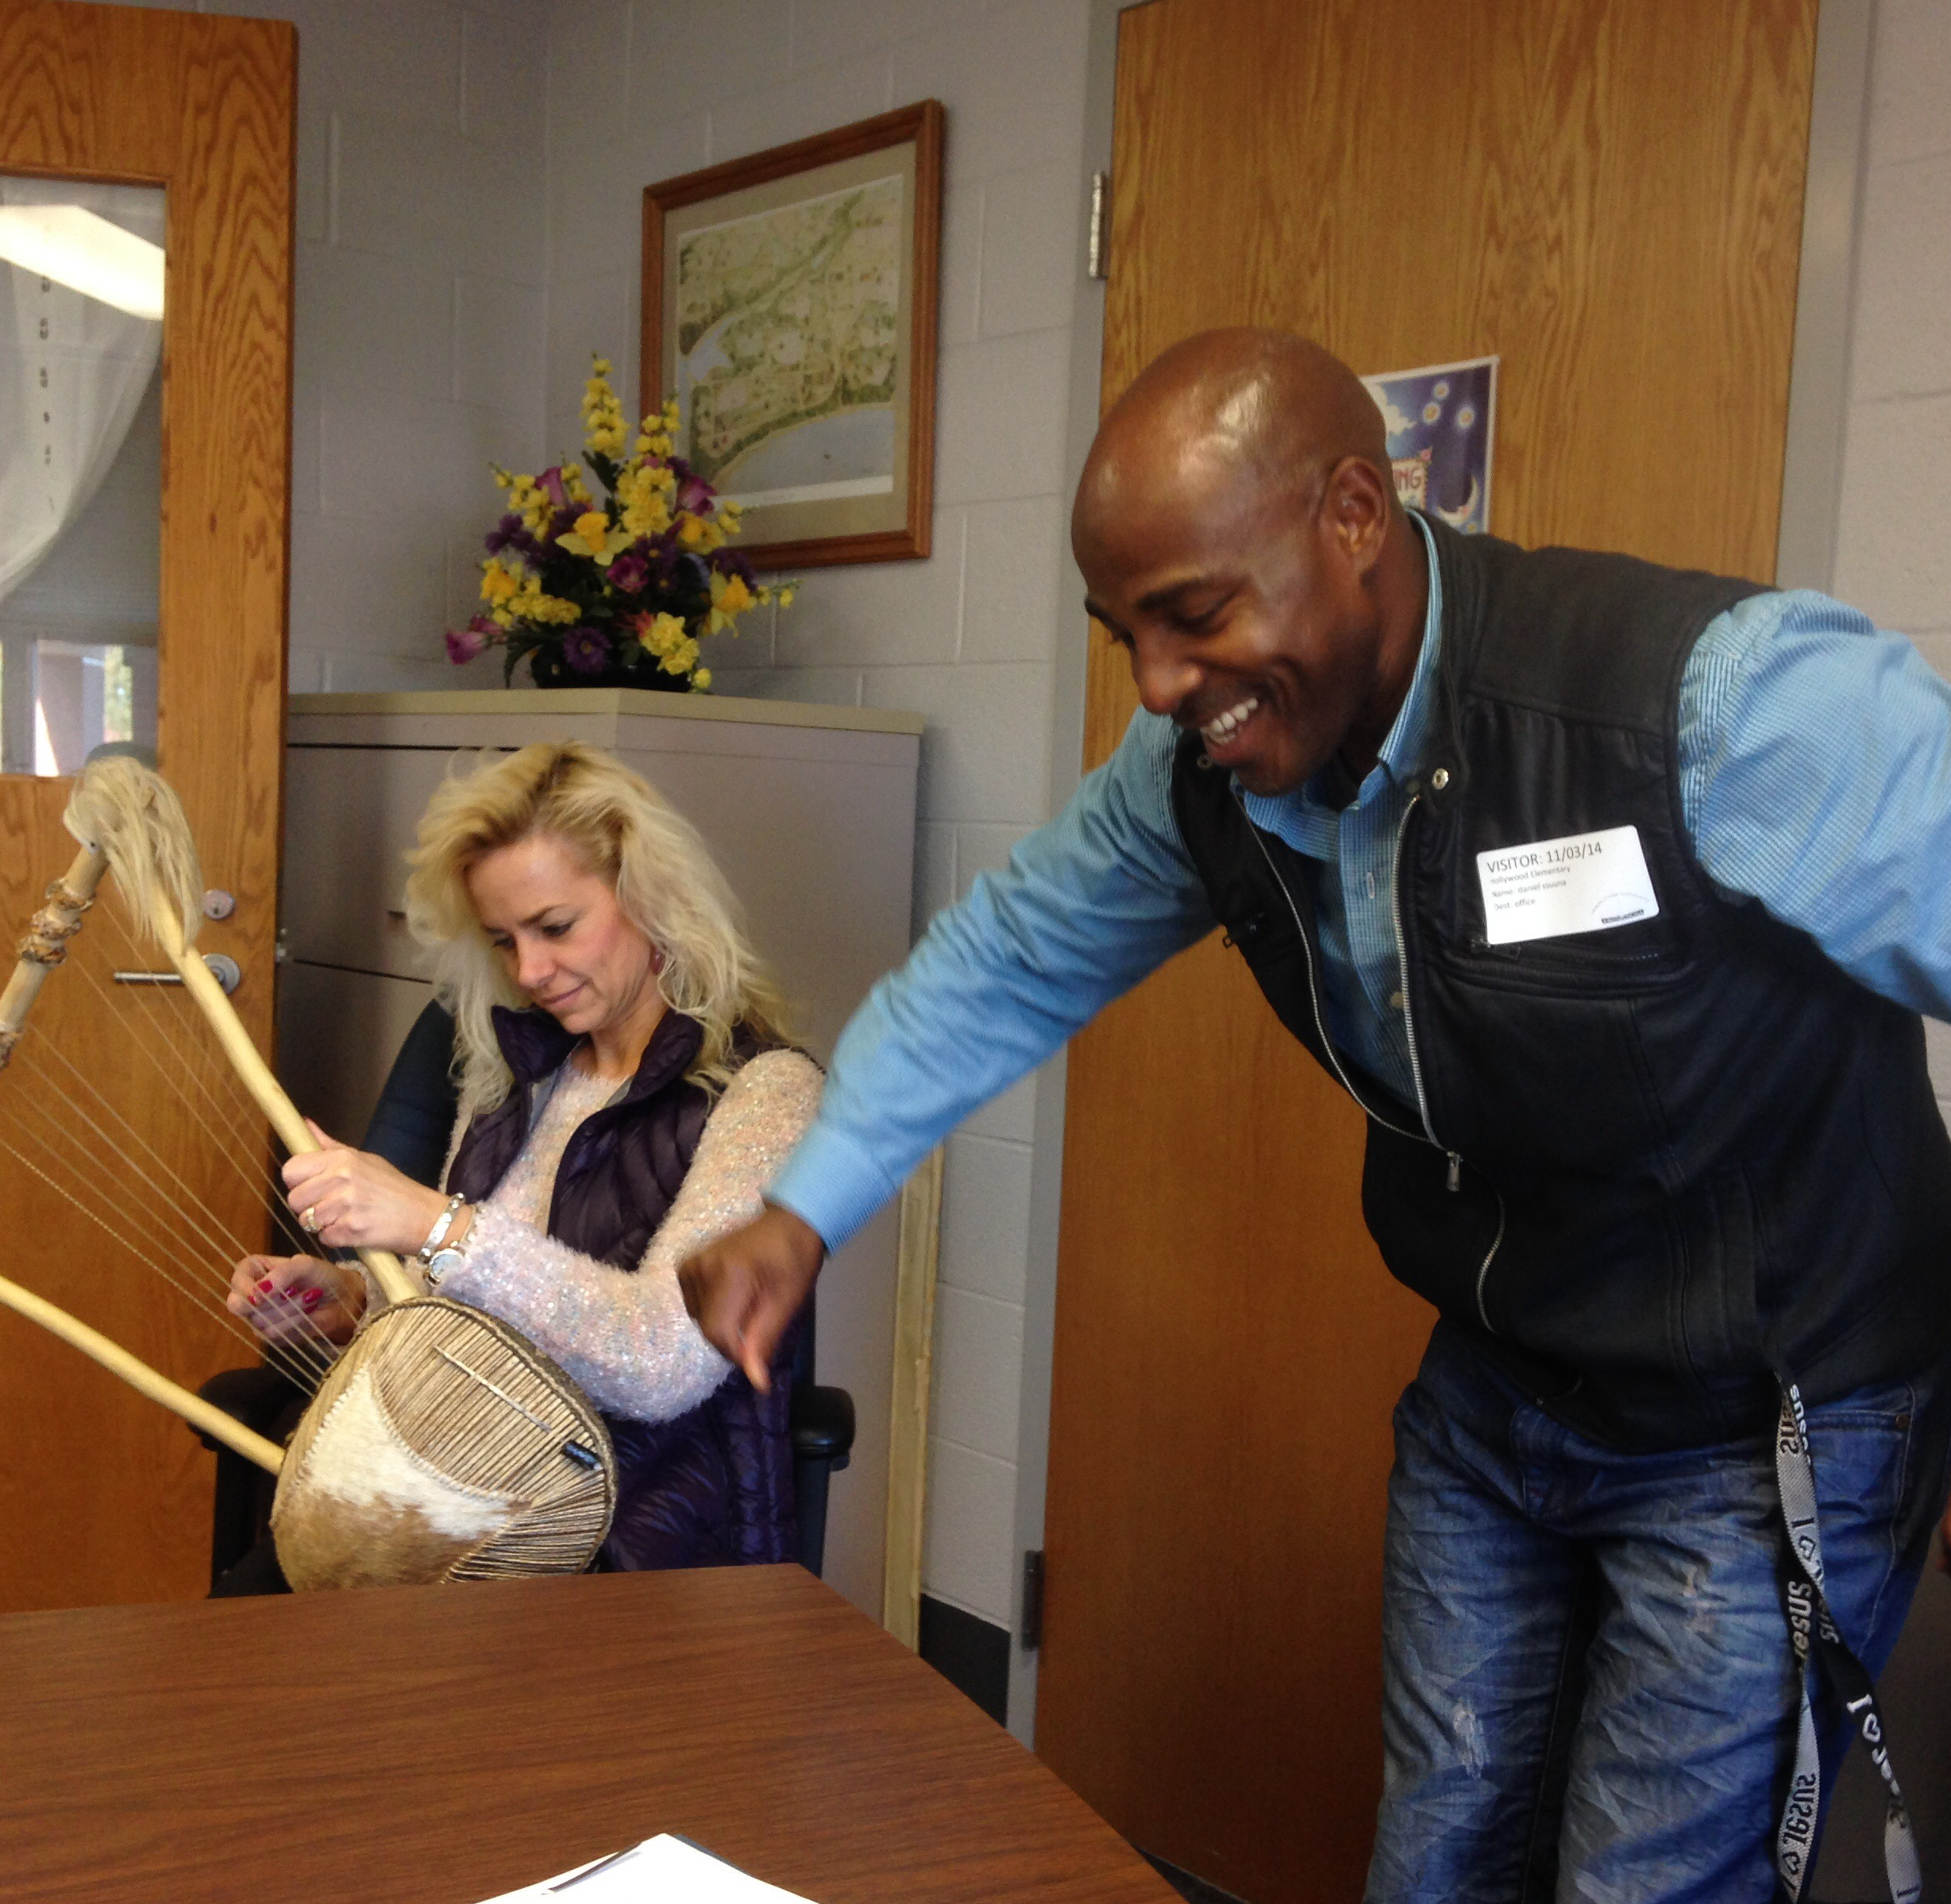
Teaching artist institute
Teacher/artist training
Collaborate to design residency
Present the plans to peers for feedback
Field test residency in schools
Tai faculty observes one lesson
Reflection meeting

Slide 7
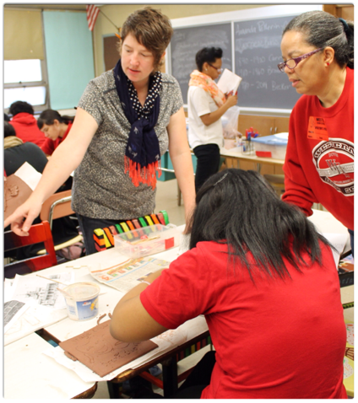
What does embedded pd look like?
Wolf Trap Early Learning
Beautiful Surprises (link)
Variations

Slide 8

Wolf trap early learning through the arts: 16 session residency program
Performing arts embedded pd residencies for early learning classrooms with a focus on literacy and stem objectives
Equal weight placed on curricular goals for students and customized professorial development goals for teacher
16 session structure, well researched model, requires intensive artist training and documentation
Outcomes/ partnering with Baltimore City Public Schools

Slide 9
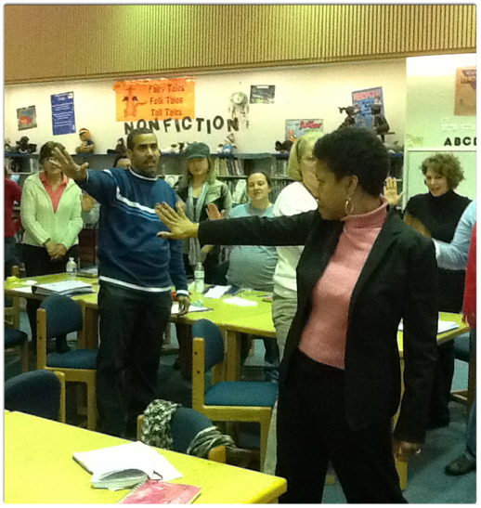
Pd residency
- planning meeting for PD & Residency
- faculty workshop
- kick off assembly
- series of 5 workshops
- more planning
- debrief
- reflection
- optional follow-up

Slide 10
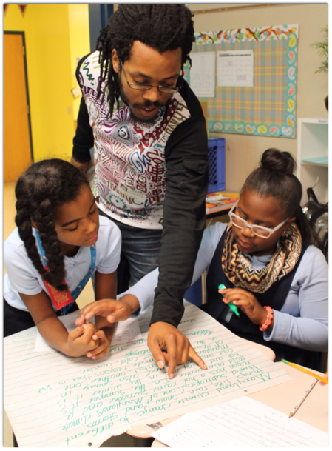
smart day
- once a week, all year program (35 sessions)
- faculty workshop
- kick off assembly
- planning day
- one workshop per teacher
- reflection meeting
- facilitator on site

Slide 11
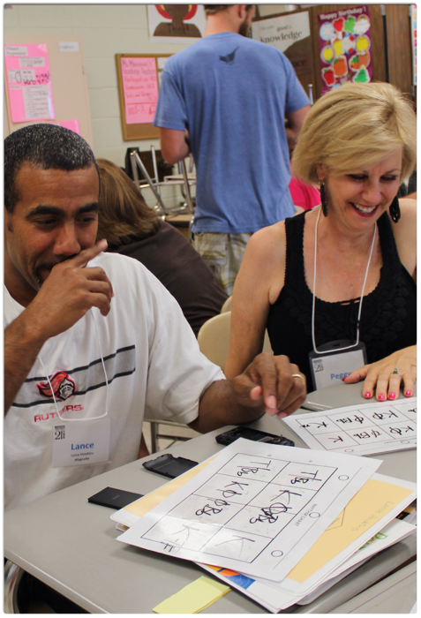
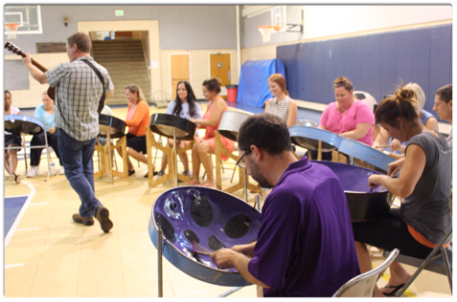
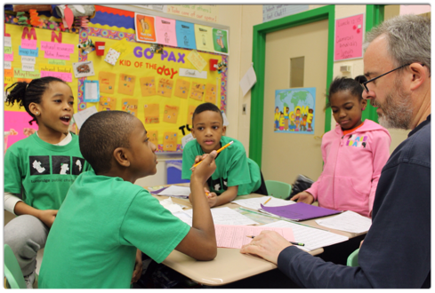

Slide 12
Creative challenge:
essential components of embedded pd residencies
Your Mission: work collaboratively to present your information to the whole group. All members of your team should be involved with designing the presentation. It may be theatrical, musical, visual, digital or anything else you can imagine.
Presentation time limit: 3 minutes
You have ?? minutes to design and rehearse your presentation.

Slide 13
Planning meeting:
Key components
Teacher, teaching artist, facilitator
Discussion & collaboration between artist & teacher
Clearly defined roles
Outlined plan/next steps

Slide 14
Workshop:
Key components
Teacher, teaching artist, students
Clear lesson objective(s)
Meaningful role for teacher that supports PD goal
Children demonstrate progress toward lesson objective
Lesson integrates art form and curriculum content

Slide 15
Reflection:
Key components
Teacher, teaching artist
Debrief discussion includes: reflection of the lesson, teacher's PD role, any modifications needed, extensions to the lesson, some planning of next lesson

Slide 16
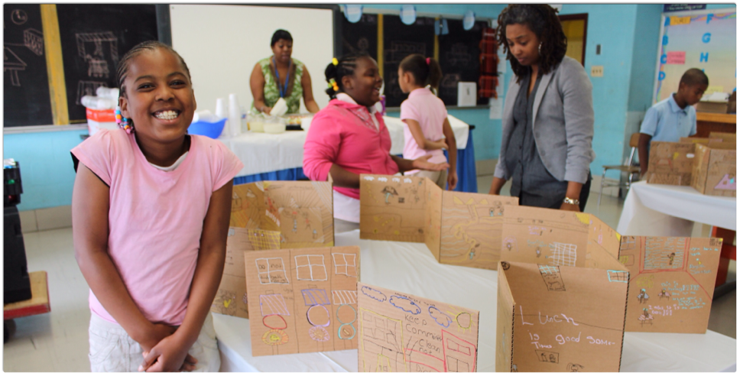
Q&A
pat@yamd.org and jessica@yamd.org

