Slide 1


ENCOURAGE CREATIVITY:
Messaging & Advocacy for Arts Education
Jeff M. Poulin
Arts Education Program
www.americansforthearts.org
FOLLOW US @AMERICANS4ARTS
AND @JEFFMPOULIN

Slide 2
Goals:
EXPLORE: How does the ecosystem look?
LEARN: What is effective advocacy?
APPLY: How can we message together?
www.americansforthearts.org
FOLLOW US @AMERICANS4ARTS
AND @JEFFMPOULIN

Slide 3
Ground Rules:
You Do You: Whatever helps you learn the best
We Don’t Play The Victim: We are agents of change
Humor Me!: We will move quick, but it’s not impossible
Others?
www.americansforthearts.org
FOLLOW US @AMERICANS4ARTS
AND @JEFFMPOULIN

Slide 4

www.americansforthearts.org
FOLLOW US @AMERICANS4ARTS
AND @JEFFMPOULIN

Slide 5
Who am I?
www.americansforthearts.org
FOLLOW US @AMERICANS4ARTS
AND @JEFFMPOULIN

Slide 6
Who am I?
www.americansforthearts.org
FOLLOW US @AMERICANS4ARTS
AND @JEFFMPOULIN

Slide 7
Who am I?
www.americansforthearts.org
FOLLOW US @AMERICANS4ARTS
AND @JEFFMPOULIN

Slide 8
Who are you?
www.americansforthearts.org
FOLLOW US @AMERICANS4ARTS
AND @JEFFMPOULIN

Slide 9
What should we be advocating for?
…and don’t say for our students? Let’s talk policy!
www.americansforthearts.org
FOLLOW US @AMERICANS4ARTS
AND @JEFFMPOULIN

Slide 10
What should we be advocating for?
…and don’t say for our students? Let’s talk policy!
www.americansforthearts.org
FOLLOW US @AMERICANS4ARTS
AND @JEFFMPOULIN

Slide 11
Where do we have the most influence?
Meet someone new in the room and discuss how you may advocate to them about arts education.
www.americansforthearts.org
FOLLOW US @AMERICANS4ARTS
AND @JEFFMPOULIN

Slide 12
Where do we have the most influence?
Meet someone new in the room and discuss how you may advocate to them about arts education.
www.americansforthearts.org
FOLLOW US @AMERICANS4ARTS
AND @JEFFMPOULIN

Slide 13
Where do we have the most influence?
Share Out!
Meet someone new in the room and discuss how you may advocate to them about arts education.
www.americansforthearts.org
FOLLOW US @AMERICANS4ARTS
AND @JEFFMPOULIN

Slide 14

www.americansforthearts.org
FOLLOW US @AMERICANS4ARTS
AND @JEFFMPOULIN

Slide 15
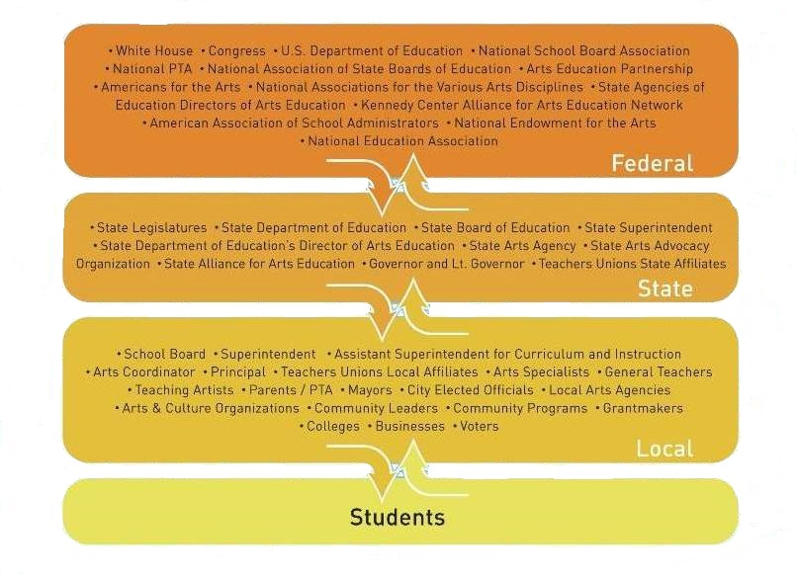
www.americansforthearts.org
FOLLOW US @AMERICANS4ARTS
AND @JEFFMPOULIN

Slide 16
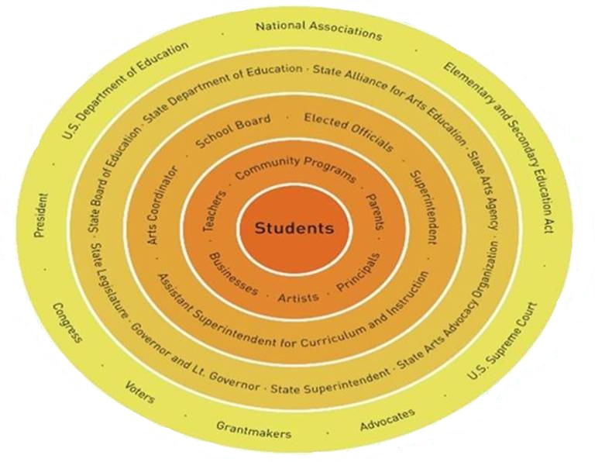
www.americansforthearts.org
FOLLOW US @AMERICANS4ARTS
AND @JEFFMPOULIN

Slide 17
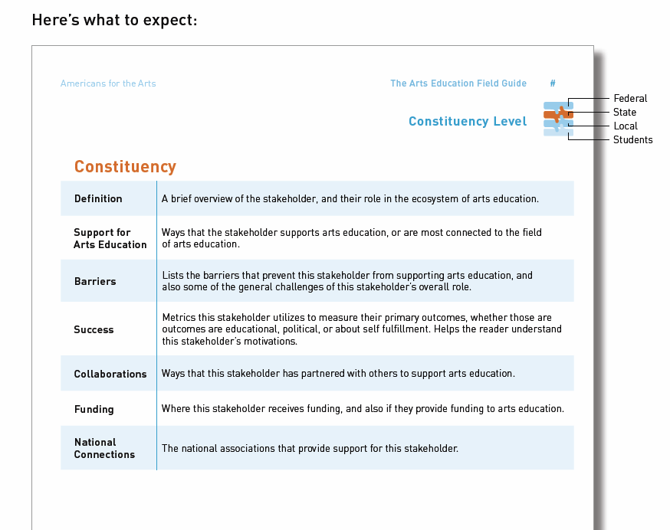
www.americansforthearts.org
FOLLOW US @AMERICANS4ARTS
AND @JEFFMPOULIN

Slide 18
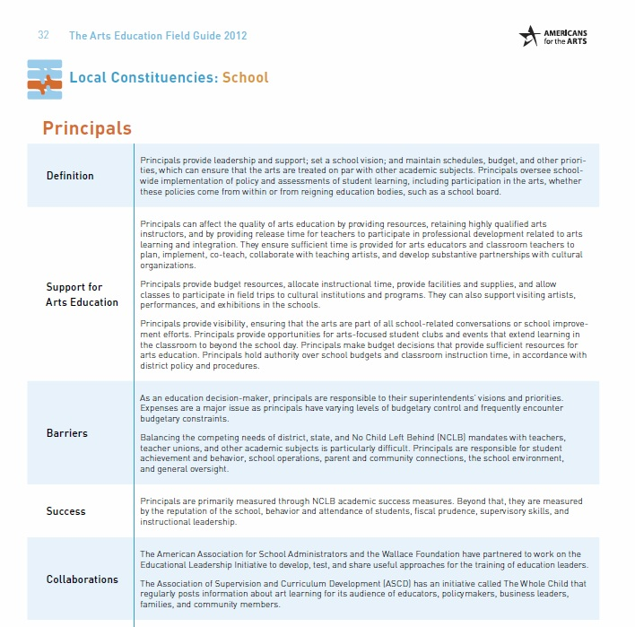
www.americansforthearts.org
FOLLOW US @AMERICANS4ARTS
AND @JEFFMPOULIN

Slide 19
Where do we have the most influence?
One more time…
Meet someone new in the room and discuss how you may advocate to them about arts education.
www.americansforthearts.org
FOLLOW US @AMERICANS4ARTS
AND @JEFFMPOULIN

Slide 20
What is advocacy?
Turn to a partner and take 2 minutes to draw up a proposed definition of advocacy to share.
www.americansforthearts.org
FOLLOW US @AMERICANS4ARTS
AND @JEFFMPOULIN

Slide 21
What is advocacy?
Share out!
Turn to a partner and take 2 minutes to draw up a proposed definition of advocacy to share.
www.americansforthearts.org
FOLLOW US @AMERICANS4ARTS
AND @JEFFMPOULIN

Slide 22
Implementers
Policy Makers
Thinkers/Best Practice
www.americansforthearts.org
FOLLOW US @AMERICANS4ARTS
AND @JEFFMPOULIN

Slide 23
Implementers
Policy Makers
Thinkers
www.americansforthearts.org
FOLLOW US @AMERICANS4ARTS
AND @JEFFMPOULIN

Slide 24
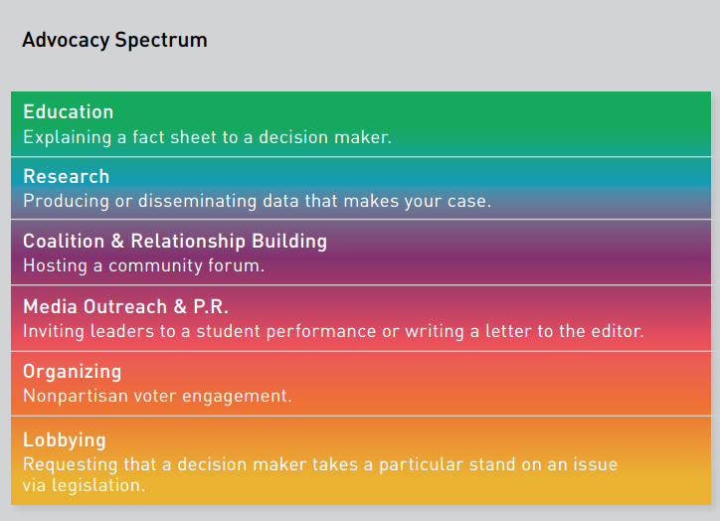
www.americansforthearts.org
FOLLOW US @AMERICANS4ARTS
AND @JEFFMPOULIN

Slide 25
www.americansforthearts.org
FOLLOW US @AMERICANS4ARTS
AND @JEFFMPOULIN

Slide 26
What missing?
www.americansforthearts.org
FOLLOW US @AMERICANS4ARTS
AND @JEFFMPOULIN

Slide 27
Making Your Case
Compelling Data
Effective Storytelling
Advocacy for Policy Change
www.americansforthearts.org
FOLLOW US @AMERICANS4ARTS
AND @JEFFMPOULIN

Slide 28
Making Your Case
Compelling Data
Effective Storytelling
Advocacy for Policy Change
www.americansforthearts.org
FOLLOW US @AMERICANS4ARTS
AND @JEFFMPOULIN

Slide 29
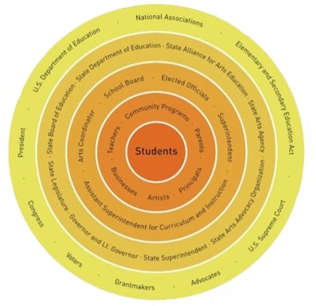
Putting It All Together
Compelling Data
Effective Storytelling
Advocacy for Policy Change
www.americansforthearts.org
FOLLOW US @AMERICANS4ARTS
AND @JEFFMPOULIN

Slide 30
What is advocacy?
One more time…
Turn to a partner and take 2 minutes to draw up a proposed definition of advocacy to share.
www.americansforthearts.org
FOLLOW US @AMERICANS4ARTS
AND @JEFFMPOULIN

Slide 31
Can we make our case?
For 5-7 minutes in a small group.
On a piece of paper, identify your audience, choose your strategy and develop your theory of change.
www.americansforthearts.org
FOLLOW US @AMERICANS4ARTS
AND @JEFFMPOULIN

Slide 32
In your small group…
Compelling Data
Effective Storytelling
Advocacy for Policy Change
www.americansforthearts.org
FOLLOW US @AMERICANS4ARTS
AND @JEFFMPOULIN

Slide 33
Can we make our case?
Share out!
For 5-7 minutes in a small group.
On a piece of paper, identify your audience, choose your strategy and develop your theory of change.
www.americansforthearts.org
FOLLOW US @AMERICANS4ARTS
AND @JEFFMPOULIN

Slide 34
Tools to Use
The Arts Education Field Guide
The Navigator E-Books
  Getting Started
  Facts & Figures
  Making the Case
  Mobilizing Support
Encourage Creativity Toolkit
www.americansforthearts.org
FOLLOW US @AMERICANS4ARTS
AND @JEFFMPOULIN

Slide 35
Messaging Keys
Encourage Creativity
Teach the Arts
www.americansforthearts.org
FOLLOW US @AMERICANS4ARTS
AND @JEFFMPOULIN

Slide 36
www.americansforthearts.org
FOLLOW US @AMERICANS4ARTS
AND @JEFFMPOULIN

Slide 37
Can we make our case?
One more time…
For 5-7 minutes in a small group.
On a piece of paper, identify your audience, choose your strategy and develop your theory of change.
www.americansforthearts.org
FOLLOW US @AMERICANS4ARTS
AND @JEFFMPOULIN

Slide 38
Goals:
EXPLORE: How does the ecosystem look?
LEARN: What is effective advocacy?
BRAINSTORM: How can these work together?
www.americansforthearts.org
FOLLOW US @AMERICANS4ARTS
AND @JEFFMPOULIN

Slide 39
Questions?
www.americansforthearts.org
FOLLOW US @AMERICANS4ARTS
AND @JEFFMPOULIN

Slide 40
ENCOURAGE CREATIVITY:
Messaging & Advocacy for Arts Education
Thank you!
Jeff M. Poulin
Arts Education Program
www.americansforthearts.org
FOLLOW US @AMERICANS4ARTS
AND @JEFFMPOULIN

